Slide 1
Publishing ELSI in Scientific Journals

Slide 2
Claudia Gonzaga-Jauregui, PhD
Assistant Professor, International Laboratory for Human Genome Research, Universidad Nacional Autónoma de México (UNAM)
Editorial Board Member, American Journal of Human Genetics (AJHG)
Editorial Board Member, Rare Journal
Associate Editor, Frontiers in Genetics
Associate Editor, Heliyon Genetics Section

Slide 3
About AJHG
Flagship scientific journal of the American Society of Human Genetics (ASHG)
Topics range from Mendelian disorders and complex traits to epidemiological studies and population genetics, novel tools and technologies for genetic analysis, and advances in medical applications of genetics and genomics.
AJHG publishes commentaries and discussion pieces intended to generate conversation about issues important to the human genetics and genomics community
ASHG Guidelines, Perspectives and Recommendations on ELSI topics
HGGA (Human Genetics and Genomics Advances) is the newest full open access journal of ASHG publishes a wide-range of research in human genetics and genomics.

Slide 4
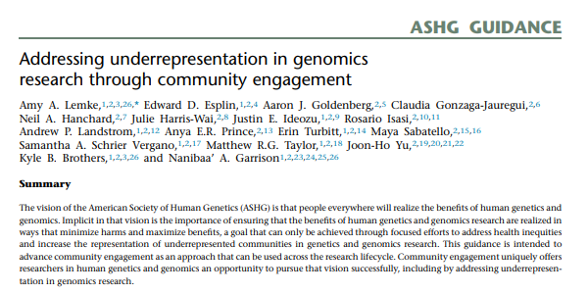
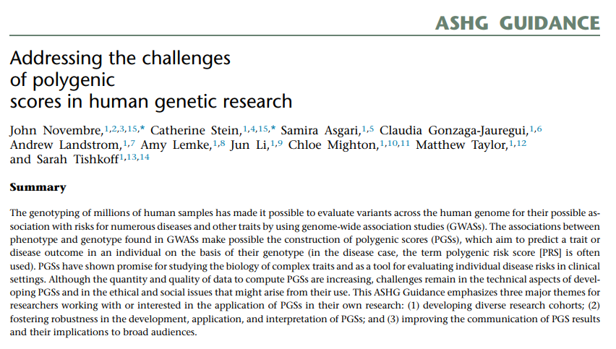
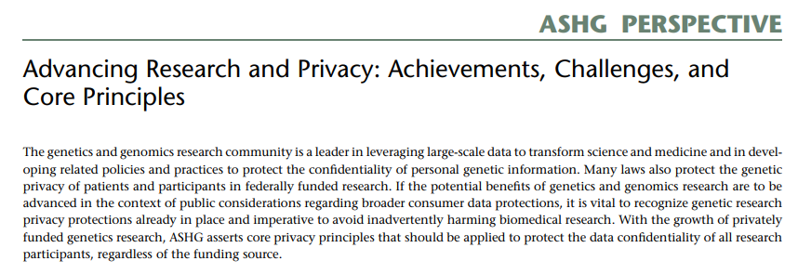
About AJHG

Slide 5
Consider Your Audience
What readership do you want to reach? Who do you want to read your paper?
ELSI in human genetics/genomics research
More clinical focus or ELSI of clinical implementation
ELSI considerations on specific diseases
ELSI considerations on specific contexts

Slide 6
Consider Special Topics
Some publishers have Topic specific journals
i.e. Frontiers in Public Health, Public Health Reviews, Frontiers in Reproductive Health, Rare, etc.
Some journals have Special Editions or Focused Research Topics
i.e. “Research and Diagnosis of Rare Diseases in Low and Middle Income Countries”

Slide 7
Thank you
Claudia gonzaga-Jauregui
@cgonzagaj

