Slide 1
Genomics and the Environment: Communicating the Complexities
Shawneequa L. Callier, JD, MA
Associate Professor Clinical Research and Leadership School of Medicine and Health Sciences George Washington University | Special Volunteer Center for Research on Genomics & Global Health National Human Genome Research Institute National Institutes of Health
May 11, 2023
Personal Genetics Education Project
ELSIhub, Center for ELSI Resources and Analysis

Slide 2
Disclaimers
The speaker declares no financial or other conflicts of interest
Opinions expressed are my own and should not be construed as the views of my affiliate institutions

Slide 3
Agenda
Complexities in understanding genomics, health, and the environment
Example obstacles to effective communication about difference and the potential consequences

Slide 4
Complexities: Genomics and Difference
We are more alike across populations than different
Genomic differences are important contributors to health
There are no biological races
Research shows that racism and discrimination affect health and disease
“. . . one of the great truths to emerge from this triumphant expedition inside the human genome is that in genetic terms, all human beings, regardless of race, are more than 99.9 percent the same.” -Bill Clinton (June 2000)
Notes:
https://www.genome.gov/10001356/june-2000-white-house-event/

Slide 5
Kalash
Balochi
Pashtun
Pathan
Burusho
PJL
STU
Arunthathiyar
Kanjars
BEB
SGVP_INS
MbutiPygmy
Juhoansi
San
Khomani2
Xun
XunV
Nama
ColouredColesberg
ColouredEC
ColouredWellington
SEBantu
BantuSouthAfrica
ACB
Mandenka
MSL
YRI
Hausa
Bamoun
Fang
BantuKenya
Bulala
Gumuz
Mada
MKK
Tygray
EthiopiaJ
Agaw
EthiopianAmhara
EthiopianOromo
EthiopianSomali
AriBlacksmith
Morocco_N
Egypt
Libya
Mozabite
Morocco_S
BiakaPygmy
Juhoan
Khomani
Karretjie
Xun2
GuiGhanaKgal
Basters
ColouredD6
ColouredNC
Khwe
amaXhosa
SWBantu
ASW
GWD
Yoruba
ESN
Brong
Kongo
Kaba
LWK
Sudanese
Anuak
Hadza
Sandawe
EthiopianTigray
Wolayta
Amhara
Oromo
Somali
AriCultivator
MoroccoJ
Algeria
Egypt2
Sahrawi
Morocco
Tunisia
Mari
Mordovia
Russian
Belorussia
Ukraine
Slovenian
Bulgaria
CEU
French
Canary Islands
Spain
Basque1
Sardinian
TSI
AshkenaziE
BulgariaJ
GeorgiaJ
TurkeyJ
Lebanon
Jordan
Palestinian
Druze
Armenia
IraqJ
IranJ
Balkar
Adygei
Abkhasian
Kurd2
Yemen
SaudiArabia
Qatari
Chuvash
FIN
Lithuania
Estonia
Orcadian
Hungary
Romania
GBR
Andalusia
IBS
Galicia
Basque2
NorthItalian
Tuscan
AshkenaziW
RomaniaJ
Cyprus
Turkey
Lebanon2
Syria
Samaritan
AzerbaijanJ
Armenia2
Georgia
NorthOssetia
Kumyk
Chechen
Iran
Lezgian
YemenJ
Bedouin
Melanesian
JPT
HanNChina
Tujia
CHS
Miaozu
Paniya
Lahu
Cambodian
Dai
PEL
CLM
Papuan
Japanese
CHB
Han
She
SGVP_CHS
Burmese
KHV
CDX
MXL
PUR
Complexities: Genomics
Makrani
Brahui
Sindhi
MumbaiJ
GIH
TamilNadu
Kanjar
ITU
Malaya
Mongolia
Even
Evenki
Yakut2
Dolgan
Selkup2
Ket2
Selkup
Tuvinian
Buryat2
Khakas
Daur
Mongolia2
Altaian
Kazakhstan
Kyrgyzstani
SGVP_MAS
Hezhen
Even2
Nganassan
Yakut
Dolgan2
Ket
Yukaghir
Buryat
Oroqen
Khasi
Nivkh
QH_Mongolian
Shor
Altaian2
Kyrgyzstan
TTR_Tibetan
Naga
Naxi
Garo
Uygur
Hazara
UzbekistanJ
Kurd
Tajikistan
Uzbekistan2
Nogai
Koryak2
Chukchi2
E.Greenland2
W.Greenland2
Surui
Colombian
Maya
Hakkipikki
KochiJ
Pulliyar
Nihali
TN_Brahmin
Kshatriya
Chenchu
Uttaranchal
Meghawal
NorthKannadi
Mawasi
PiramalaiKallars
Lambadi
Velama
Meena
Baker, J.L., Rotimi, C.N. & Shriner, D. Human ancestry correlates with language and reveals that race is not an objective genomic classifier. Sci Rep 7, 1572 (2017).
Bhunjia
Bonda
Kol
Gadaba
Chamar
Dharkar
Kharia
Juang
Santhal
Asur
Kurmi
Muslim
Gond
Dhurwa
Savara
UP_caste
UP_Brahmin
Tharu
Dusadh
Ho
Kurumba
Bengali
Maduo_Tibetan
Yizu
Tu
Xibo
Tajikistan2
Uzbekistan
Uzbekistan3
Hazara2
Turkmenistan
Turkmenistan2
Koryak
Chukchi
E.Greenland
W.Greenland
Athabask
Karitiana
Pima
South Asia
Africa
Europe, Caucasus, and Middle East
Oceania, Asia, and Americas
Notes:
***
Also scientifically, genetic ancestry is a scientific term that should be free of racial overtones. This image published in a paper by colleagues at CRGGH uses 21 colors to represent different ancestries determined from 282 global populations; the figure simultaneously shows ancestry mixture within each individual, population and geographical regions.
It emphasizes that there is continuous genetic variation among populations and no sharp boundaries between groups.
As populations continue to move and intermingle, policies must remain dynamic to ensure that investigators study and capture ancestry diversity. Studies of race are helpful when they focus on biases, racism and environmental effects

Slide 6
Complexities: Environments and SDOH
Where one lives influences health, well-being, and ability to thrive
The lives of minoritized and marginalized people are disproportionately influenced by toxic environments and disadvantages
Research that takes SDOH into account can offer valuable insights into how SDOH (including racism) affect health
Example Social Determinants of Health (Healthy People 2030)
Economic Stability
Education Access and Quality
Health Care Access and Quality
Neighborhood and Built Environment
Social and Community Context

Slide 7
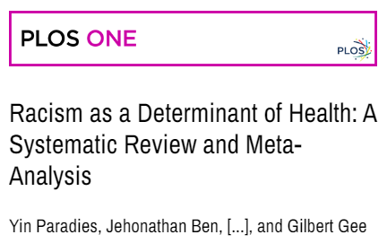
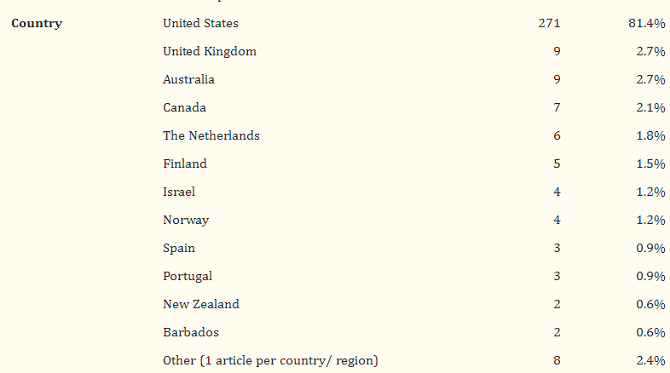
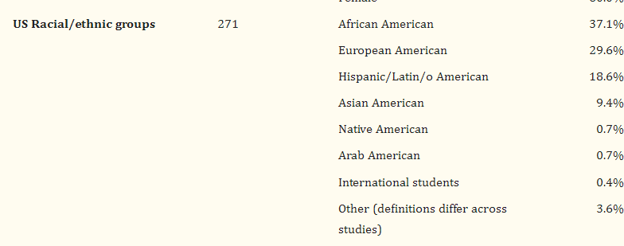
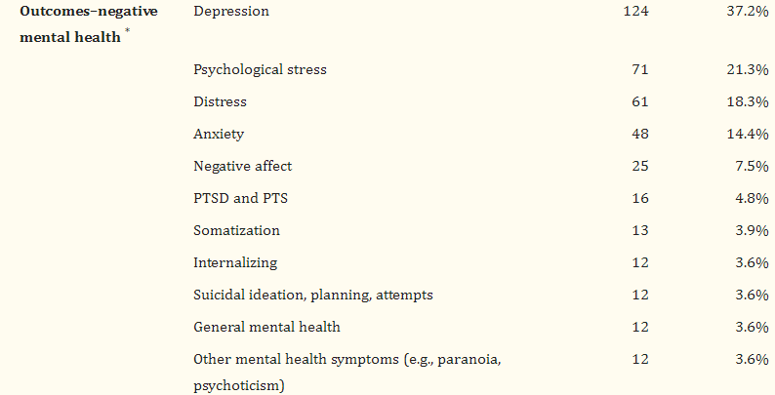

Slide 8
Example obstacles to effective communication about difference

Slide 9
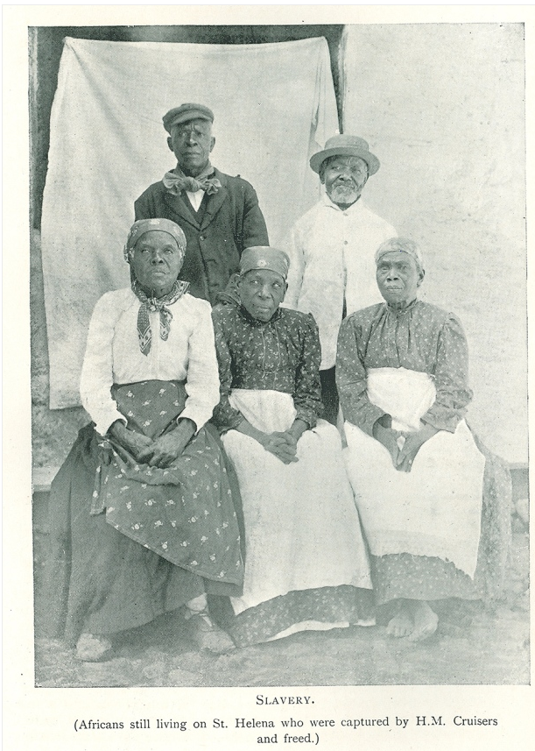
“Shipping records suggest that slave ships that landed in St. Helena had embarked from ports across Central and West Africa, including present-day Angola and the Congo region”
“‘They are of so many different tribes and districts that it would be curious, if one knew the languages, to trace them out’”

Slide 10
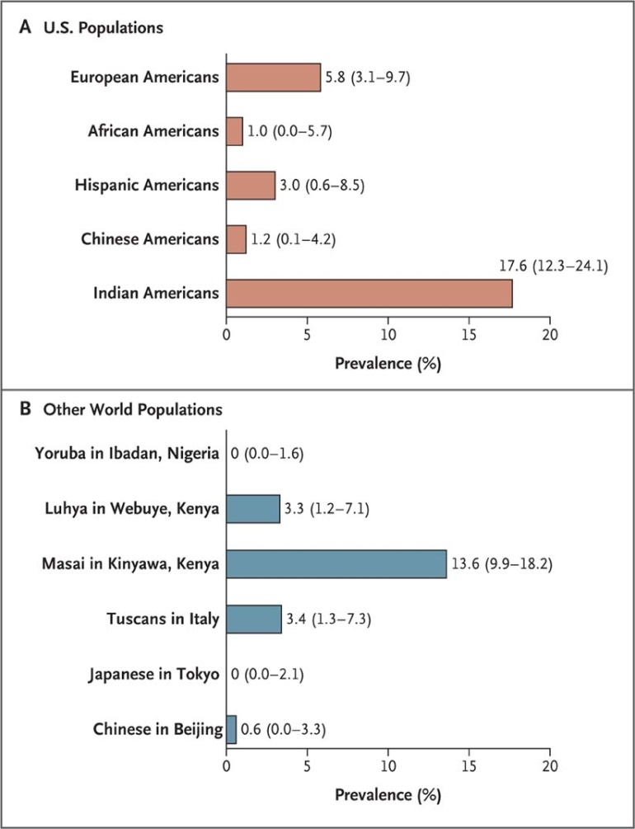
2010
Genetic Screening to Prevent Abacavir Hypersensitivity Reaction
Labels such as “Asian” “obscure biomedically relevant variation and could lead to less vigilance among physicians for AHS in susceptible patients.”
Figure 1. Variation in the HLA-B*5701 Locus in 11 HapMap Samples

Slide 11
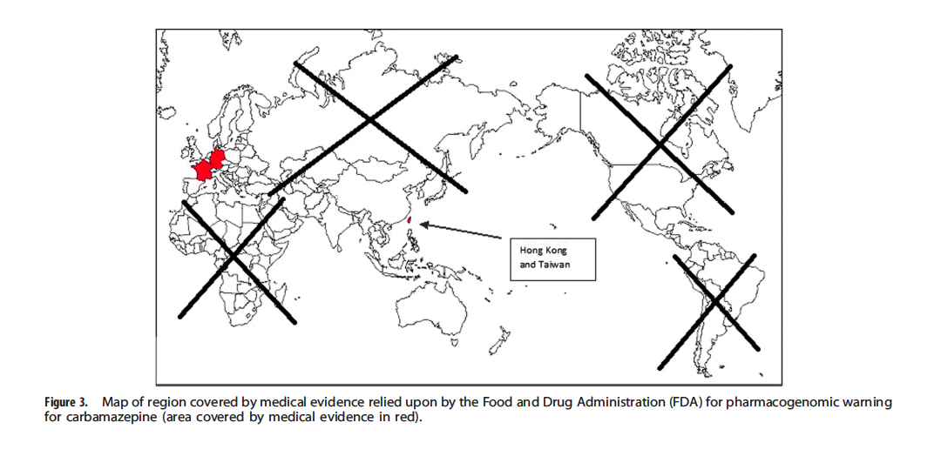

Slide 12
Perception as a Black disease
Confusion between SCT and SCD
“The sickle cell population was “clinically invisible”
Limited public understanding and awareness
See also: Wailoo, K. 2001. Dying in the city of the blues: Sickle cell anemia and the politics of race and
health. Chapel Hill, NC: University of North Carolina Press.

Slide 13
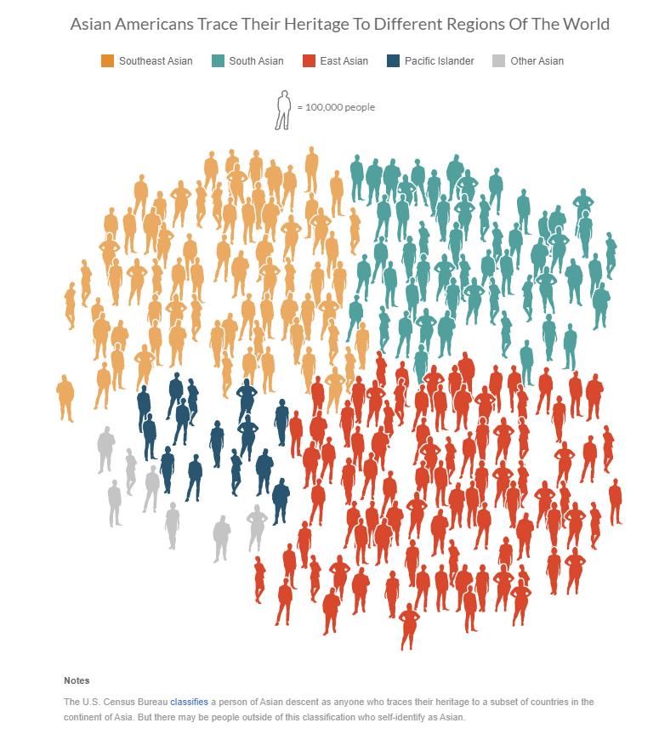
“But when you look at life expectancy in the aggregate, always comparing it to white people, you miss the diversity of those places that are winning, that are actually taking charge in spite of that constant - of racism that is a pall across the country.” –Andre Perry (NPR Interview, 2022)

Slide 14
“And, yes. Not one of us was here when this house was built. Our immediate ancestors may have had nothing to do with it, but here we are, the current occupants of a property with stress cracks and bowed walls and fissures built into the foundation. We are the heirs to whatever is right or wrong with it. We did not erect the uneven pillars or joists, but they are ours to deal with now.”

Slide 15
Acknowledgements

