Slide 1

ELSI Publishing in Bioethics Journals
Holly Tabor, PhD
Associate Professor, Department of Medicine and by courtesy, Department of Epidemiology
Associate Director, Stanford Center of Biomedical Ethics
Stanford University

Slide 2

Disclosure
Editor in Chief of the American Journal of Bioethics Empirical Research

Slide 3
American Journal of Bioethics
Empirical Research
””Publishing empirical scholarship on bioethics, including qualitative and quantitative research relating to bioethics, health policy and health services.
NOT Target articles/OPCs format of AJOB
4000 word limit (rare exceptions)
Published four times a year
Reviewer suggestions allowed

Slide 4
What are we looking for in an article?
The journal provides a forum for empirically informed scholarship in bioethics. AJOB Empirical Bioethics broadly construes empirical bioethics to include social scientific research applied to bioethical questions, health policy and health services research as it relates to bioethics, and other forms of original research.
Areas of interest include:
  conceptual analyses of the role of empirical research in bioethics
  discussions of empirical methods and how they “fit” with ethical discourse
  ethical analyses and/or critiques of empirical research and research methodology
The journal welcomes submissions that employ quantitative, qualitative, or mixed empirical methods from the broad range of disciplines relevant to bioethics inquiry. When in doubt, authors are encouraged to contact the Editor-in-Chief about whether a proposed manuscript is consistent with the journal’s mission.

Slide 5
What are we looking for in an article?
Empirical bioethics
Explicit discussion using an ethics lens
Alex Kon, AJOB Primary Research 2010
  “The journal will publish a wide array of research, including but not limited to, qualitative research, quantitative research, policy research, health service research, and public health research when such project [sic] have implications for bioethics in the broadest sense.”
Jim Dubois, AJOB 2010
  “empirical research in bioethics is research that is relevant to determining what is right or wrong, good or bad, respectful or disrespectful, caring or non-caring, or virtuous or vicious, within a bioethical debate. Thus, it might be best to speak of ethically relevant empirical data.”

Slide 6
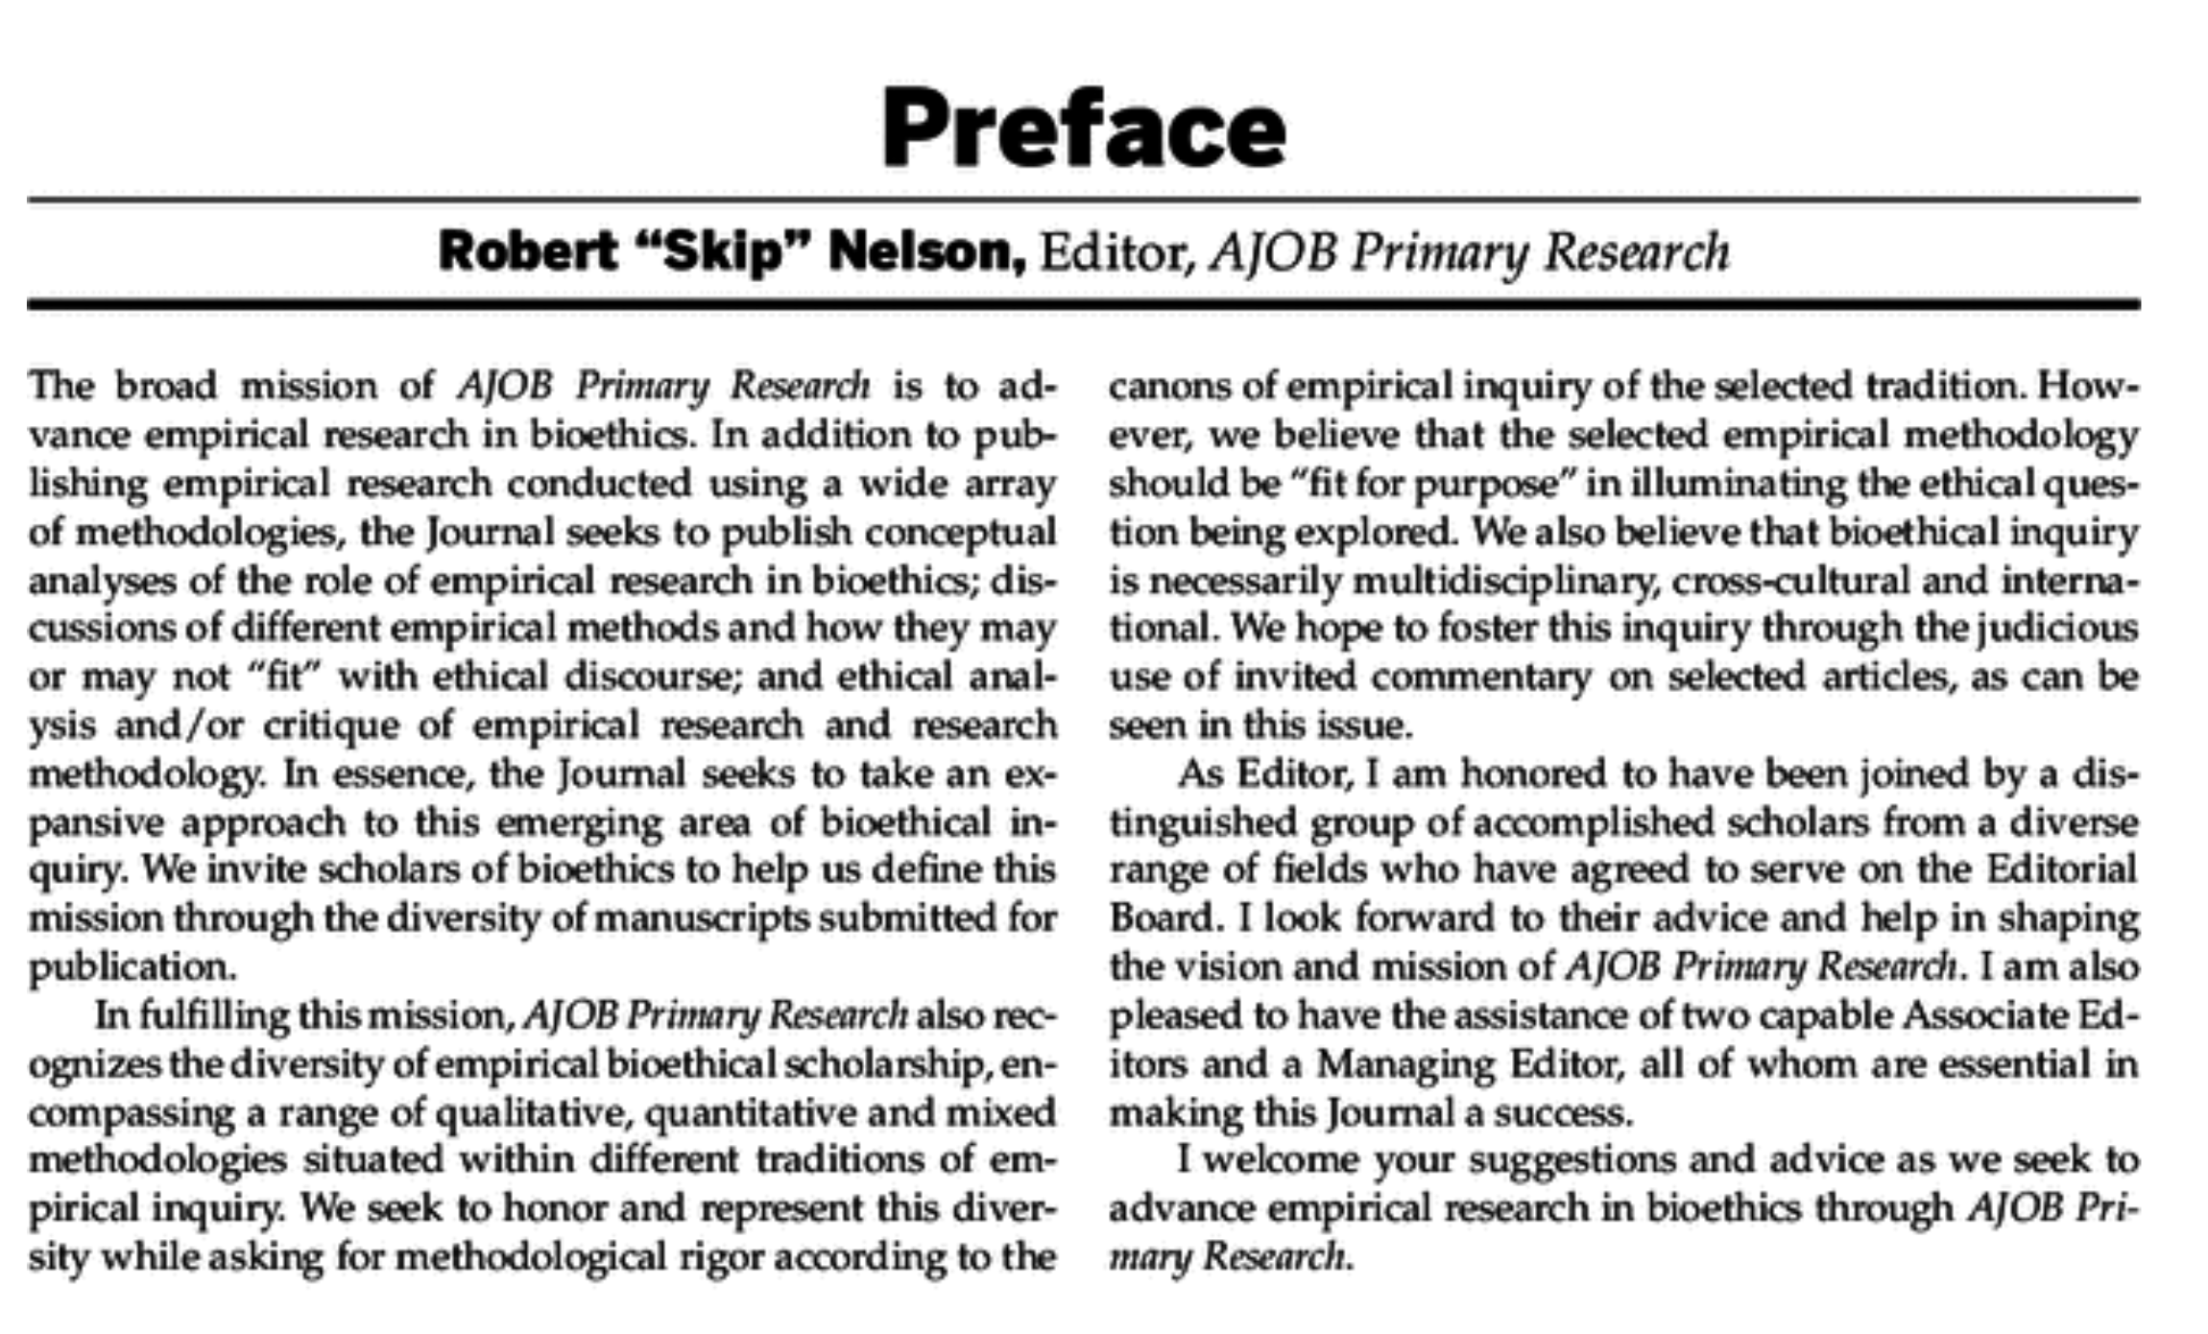

Slide 7
Why AJOB EB for ELSI research?

Slide 8

Audiences….

Slide 9

Challenges of finding reviewers

Slide 10

Please say yes!

Slide 11

Trainees

Slide 12
Tips
Make sure you follow Instructions for Authors and use the correct format (sections, citations) and word count
Looking at recently published papers published in that journal
Write a strong cover letter to contextualize what this paper is trying to do and why it’s appropriate for this journal
Reviewer suggestions (if allowed): recommend good reviewers with expertise. Sometimes journals also allow you to ask that certain people not act as reviewers.
Look at examples of reviews and responses to reviews from others. Be respectful and address every point. When possible, copy into the response changes you made to the text
Act as a reviewer: it will help you write better papers and respond better to reviews

Slide 13
Social Media and Publications

Slide 14
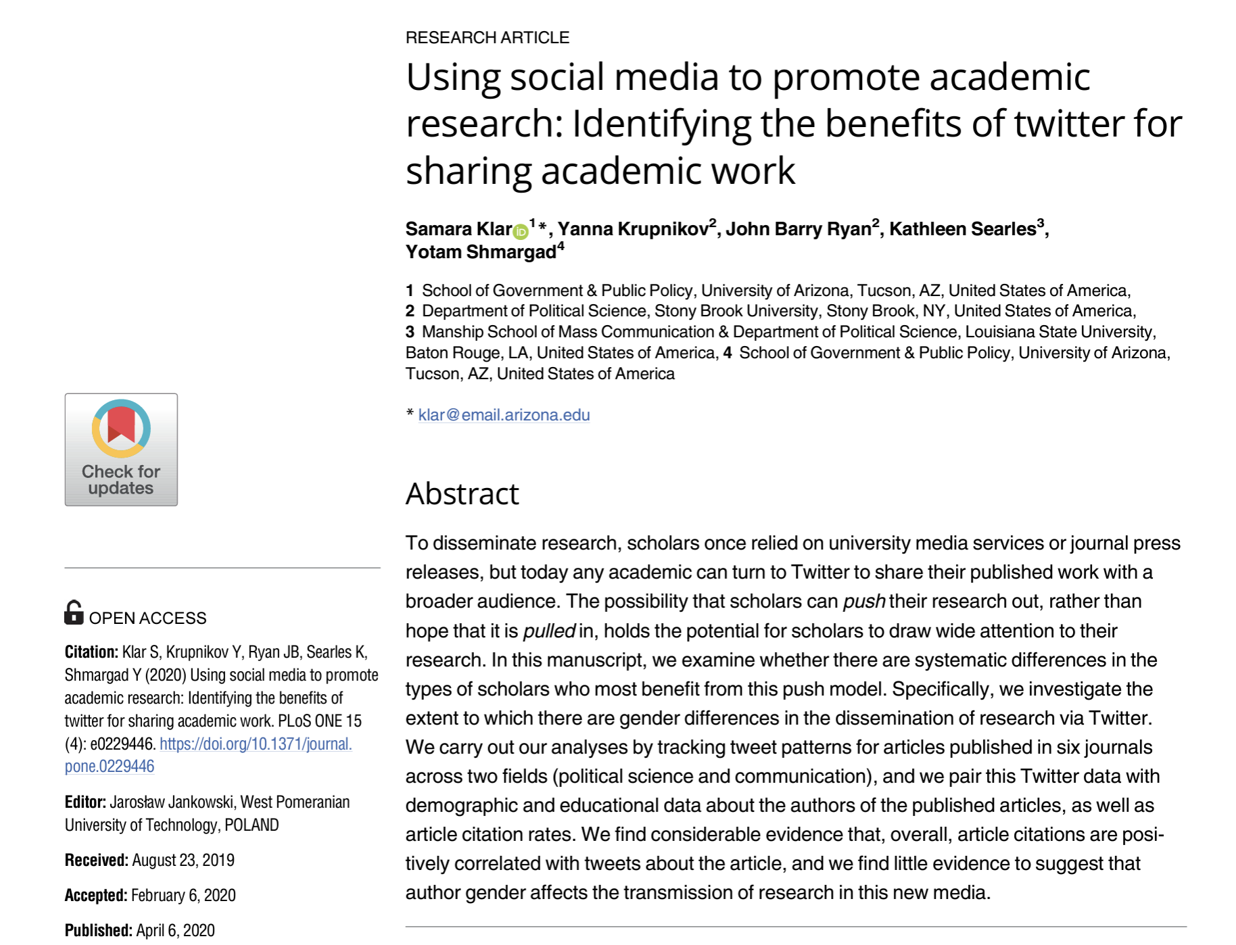
https://journals.plos.org/plosone/article?id=10.1371/journal.pone.0229446

Slide 15

https://authorservices.taylorandfrancis.com/research-impact/a-guide-to-twitter-for-researchers/

Slide 19
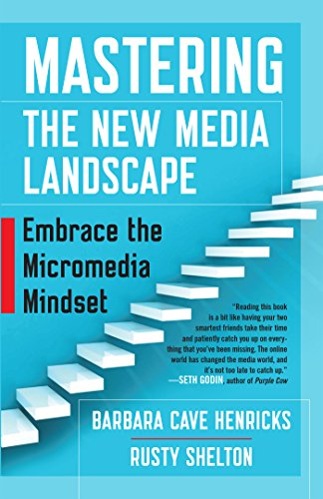

Slide 20

Diversity, equity and bias in publishing

Slide 21
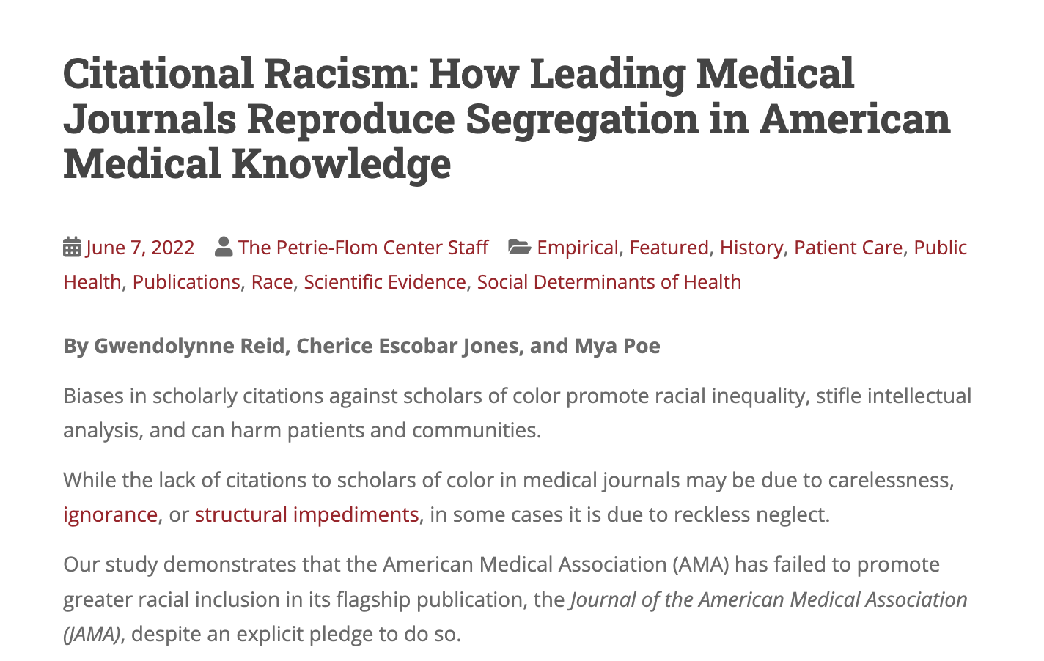
https://blog.petrieflom.law.harvard.edu/2022/06/07/citational-racism-how-leading-medical-journals-reproduce-segregation-in-american-medical-knowledge

Slide 22
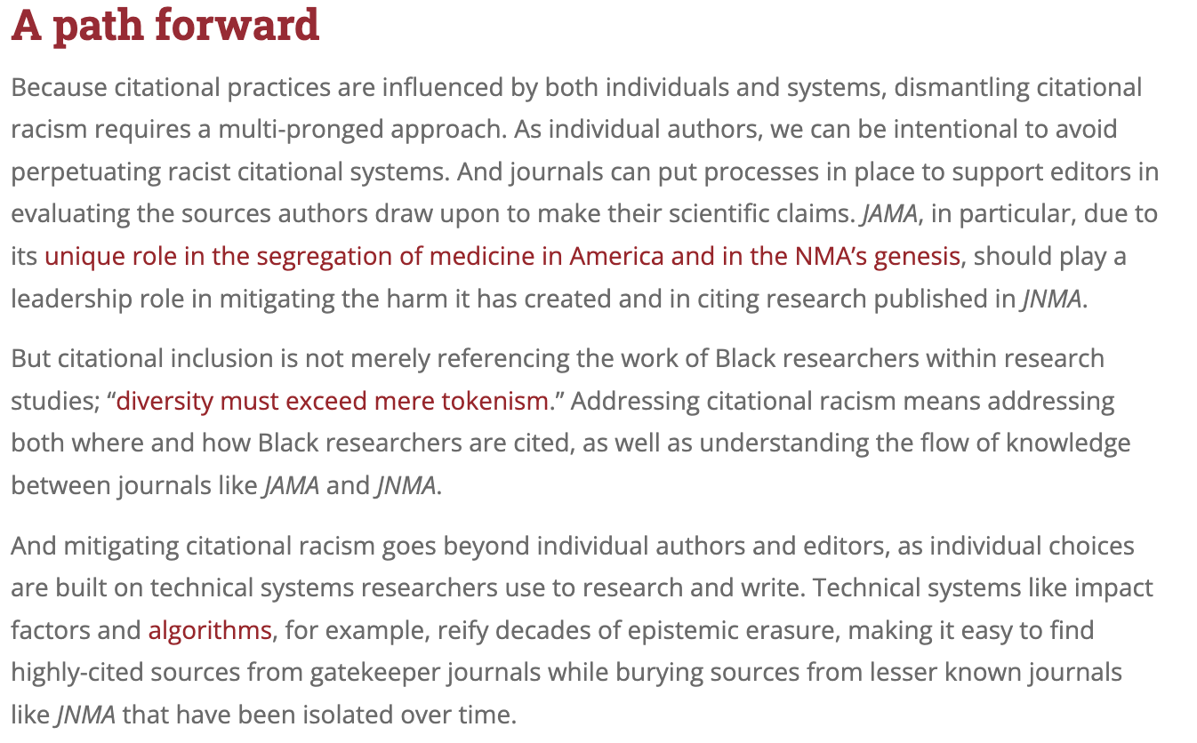

Slide 23
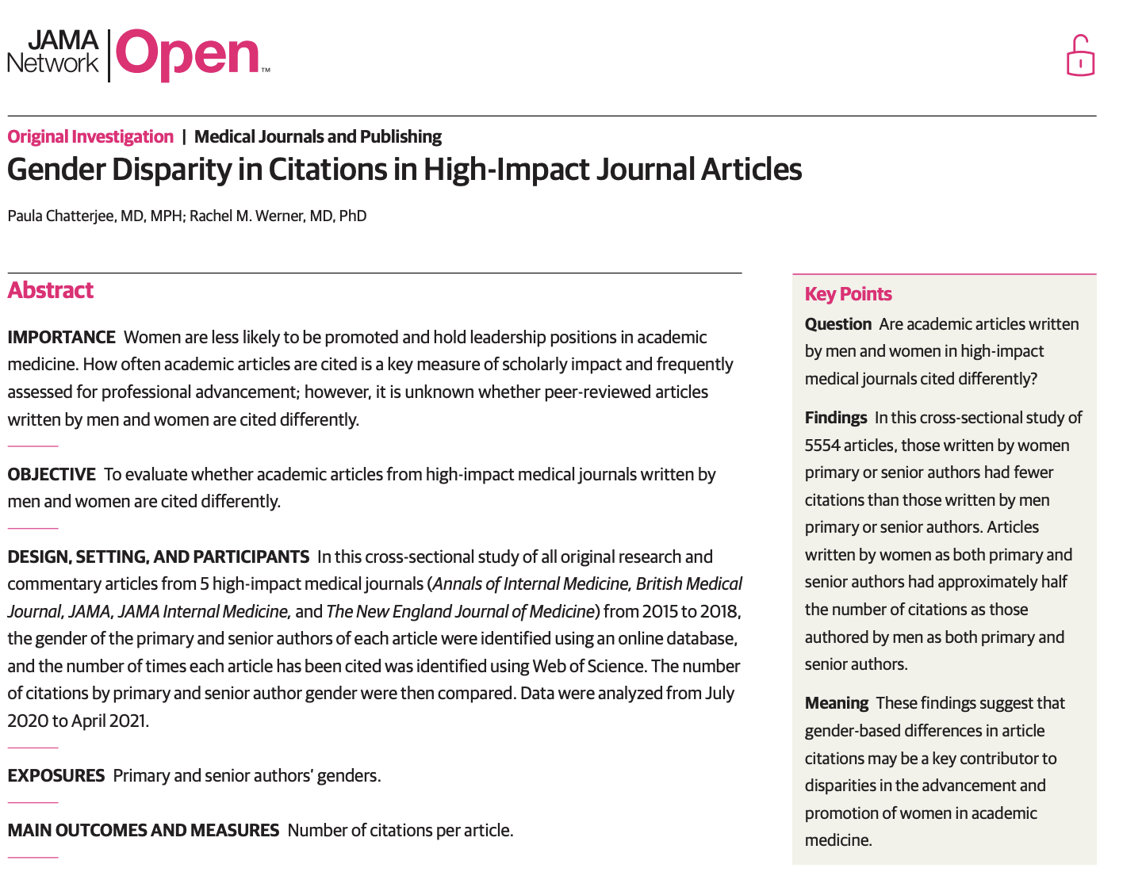
JAMA Network Open. 2021;4(7):e2114509

Slide 24

https://www.npr.org/sections/goatsandsoda/2021/09/28/1016628282/african-researchers-say-they-face-bias-in-the-world-of-science-heres-one-solutio

Slide 25
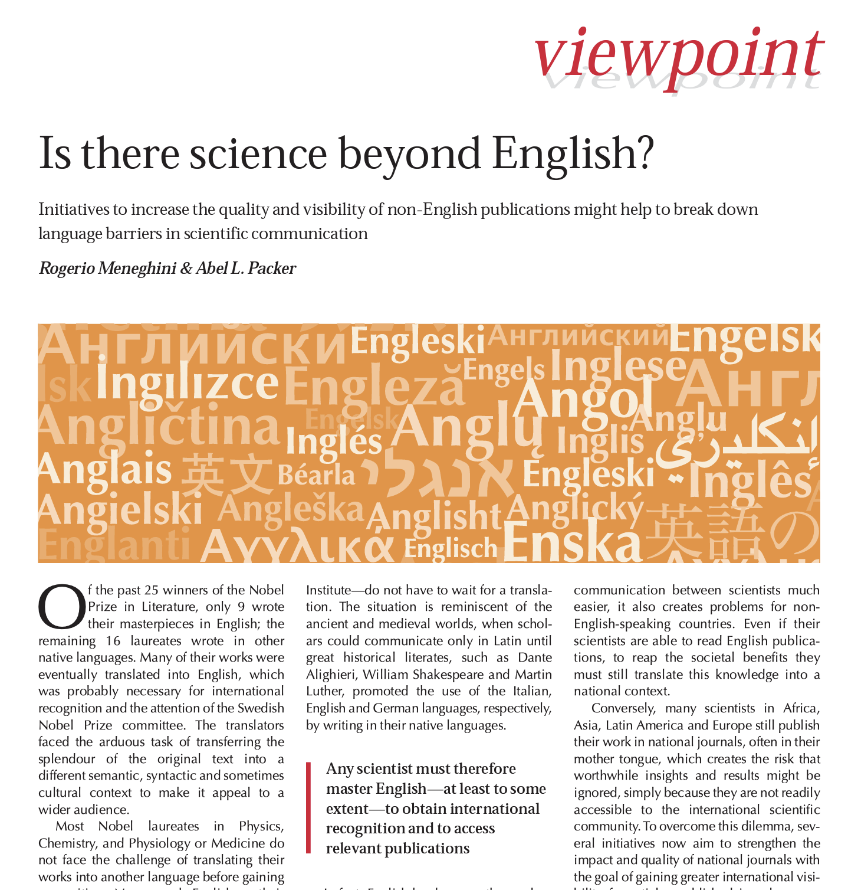
https://www.ncbi.nlm.nih.gov/pmc/articles/PMC1796769/pdf/7400906.pdf

Slide 26
Please reach out!
hktabor@stanford.edu

