Slide 2
Indigenizing Genomics and Advancing Indigenous Data Sovereignty
Krystal Tsosie, phd, mph, MA
Arizona state university
Native biodata consortium
PhiLLip Wilcox PhD
University of Otago,
New Zealand
@KSTSOSIE
@pdubotakou

Slide 3
About Us…
Dr. Krystal Tsosie, PhD, MPH, MA
Diné (Navajo Nation)
Masters of Arts (Bioethics)
Master of Public Health
PhD, Genomics and Health Disparities
Assistant Professor, Arizona State University
School of Life Sciences, Center for Biology and Society
Co-Founder, Native BioData Consortium,
SING-Aotearoa 2023 Hamilton, Aotearoa New Zealand
Notes:
Krystal first, PW next

Slide 4
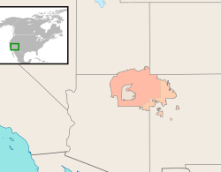
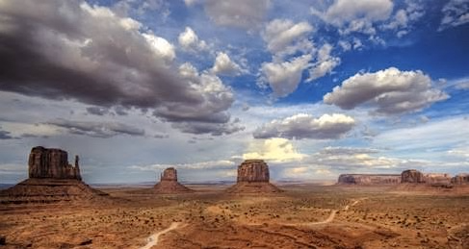
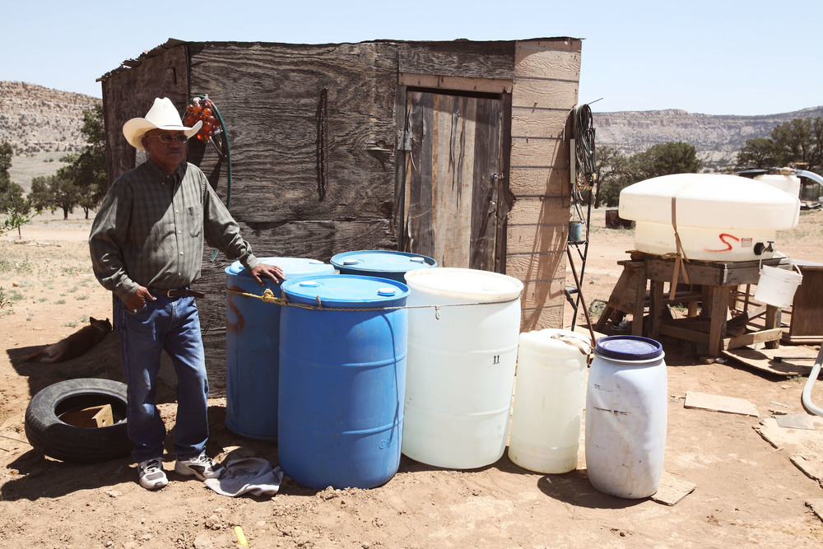
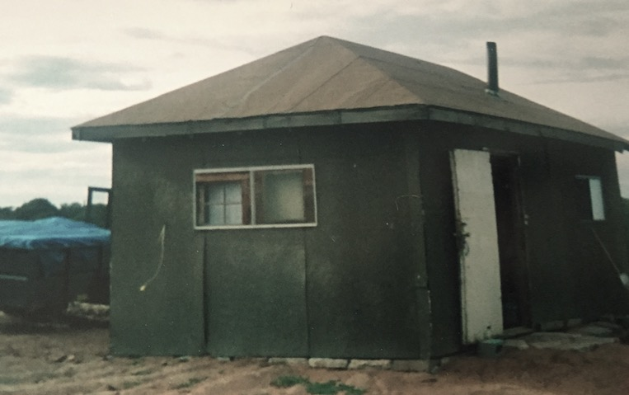
Dinétah
The Navajo Nation is the largest land area held by a Native American Tribal Nation in what is now call the the United States, exceeding the size of ten states
In 2010, there were 332,129 Navajo enrolled members
1924 – US Indigenous peoples recognized as citizens and allowed to vote (but states barred them from voting for decades)

Slide 5
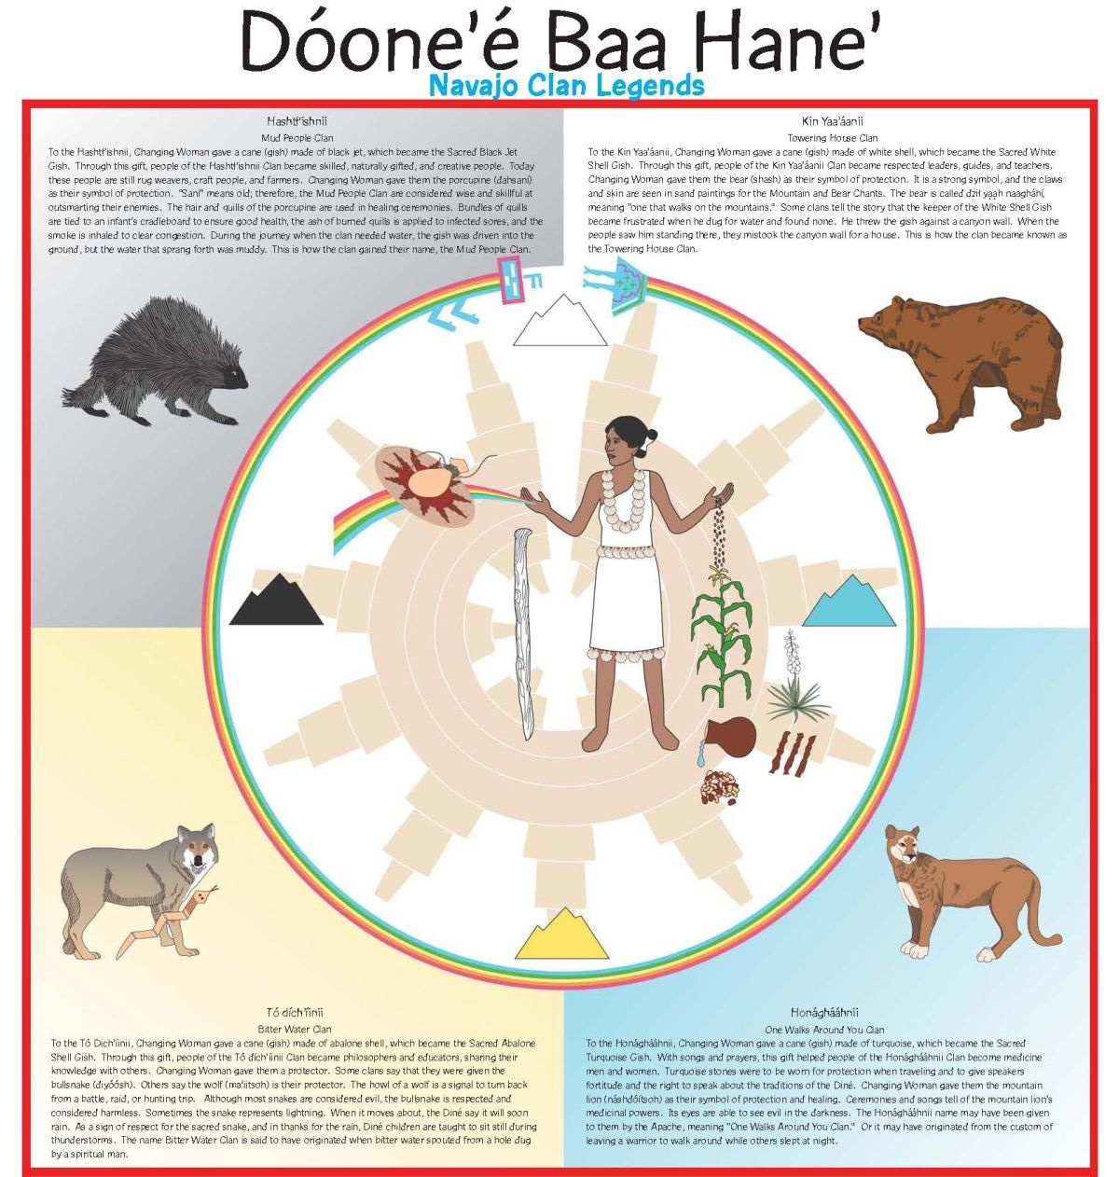
Diné bahane’
(the story of the people)
The way an individual connects his or her identity with their ancestors is through their origin story (Tewa scholar Gregory Cahete)
Summary:
Fourth or White World (present): First Man, First Woman, and Diyin Diné’e (Holy People) create the sun, moon, seasons, and stars
Changing Woman (Asdzáá Naadleehí) is first human born
Multiple batches of modern humans
Changing Woman created the first four clans of peoples and set up rules on how the Diné peoples should live. Four clans were created from various parts of her body:
Today there are a total of nine clan groupings (at one point up to 21) and more than eighty clans overall.

Slide 6
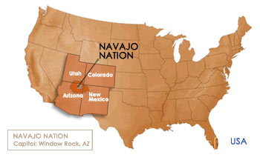
K’é’
(kinship clans)
Relatively speaking, the Diné is a rather recent tribe (over 400-500+ years)
The system of k’é’ stipulates exogamous marriage; matrilineal
The Diné originally constituted several bands who migrated between summer and winter camps
Diné expanded by taking on people from neighboring tribes.
Diné clan | Original community
Naasht'ézhi dine'é | Zuni clan
Tséńjíkiní | Honey Combed Rock People or the Cliff Dwellers People clan
Mą'ii deeshgiizhinii | Coyote Pass - Jemez clan
Naakai dine'é | The Mexican clan
Nóóda'í dine'é | The Ute clan
Naashaashi | The Bear Enemies, the Tewa clan
Naashgalí dine'é | The Mescalero Apache clan
There are “adopted clans” who are named by the location, so the original community is unclear
While our notion of identity may not be genetically-defined, there is an acknowledgement of our heterogeneous genetic backgrounds under a unified identity.
Even if it were possible to parse out genomic regions of similarity to external contributing bands (not enough reference group data), it would not matter under k’é.

Slide 7
Diné identity
The blood quantum system was imposed upon us as a system meant to dilute ourselves
Tying genetics by ancestry with being Diné would be incongruent with the traditional k’é’ system which served as the primary means of identifying kinship foricenturies
Blood quantum policy “drives a wedge between the members of the Native community by using blood to privilege some, discredit others, and ultimately racialize Native societies in ways that are foreign to Native cultural traditions…. We must move beyond histories that rely on blood”
Begay 2013
Mixed Blood Indians: Racial Construction in the Early South, Theda Perdue (2005, x)

Slide 8
About Us…
Phillip Wilcox, PhD (NCSU)
Associate Professor and Kaiawhina Māori,
Department of Mathematics and Statistics | Te Tari Pāngarau me te Tatauraka Kaikōkiri Māori, Genetics Teaching Programme
Also: Affiliate Faculty, Bioethics Centre | Te Pokapū Matatika Koiora
University of Otago | Te Whare Wānanga o Otāgo
Tribal Affiliations: Ngāti Rakaipaaka, Ngāti Kahungunu ki Wairoa, Rongomaiwahine
SING-Aotearoa 2023 Hamilton, Aotearoa New Zealand
Notes:
Krystal first, PW next

Slide 9
Some of my Māori-related professional activities
Involved in Māori-specific conversations/research regarding genetic technologies since 2001:
Established Te Arotūruki and co-developed TA Process (JRSNZ 2008)
Otago University ‘Full Circle Theme’
University of Waikato ‘Te Mata Ira’ & ‘Te Hau Mihi Ata’ projects
Various consultation with Māori communities
Māori advisory roles
Scion (GE pine, kauri transcriptomics)
Royal Society of NZ Gene Editing expert panel
Reviewer for Te Tipu o te Wānanga
Māori-specific education initiatives
Genetics modules in Science Wānanga for 11-14 year old Māori high school students
Summer Internship of Indigenous Peoples in Genomics (SING-Aotearoa)
Trained/ing 8 Māori graduate students in genetics
Kaikōkiri Māori – specific role at UoO for oversighting Māori content in genetics degree
Scientific Research
24 years forestry + 10 years medical genetics research
Science Leader, Virtual Institute of Statistical Genetics (visg.co.nz)
GA-funded Aotearoa Variome project co-lead*
Co-led Māori components in successful NZ$35M Genomics Aotearoa Proposal
Iwi (= tribal) roles
Previously mandated representative for Ngāti Rakaipaaka
Advisor for various iwi initiatives e.g. Ngāti Kohatu
Science advisor for various proposals in Wairoa/Mahia area
University-specific activities
Maths and Stats Dept Kaiawhina
Sci Div Māori Leadership roopu
Overviewing & teaching UoO Science Wānanga Māori outreach
Teaching Māori ethical frameworks and consultation requirements in 100-400-level science courses
Notes:
Wide range of roles, PhD level training in genomic sciences led genomics informed research in forestry, statistical genetics and human genetics. Worked with my tribe in various genetics-related initiatives, 18 years of research into processes for improved engagement with Māori communities as well as various other roles including Māori ethical frameworks

Slide 10
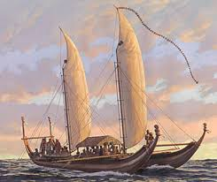
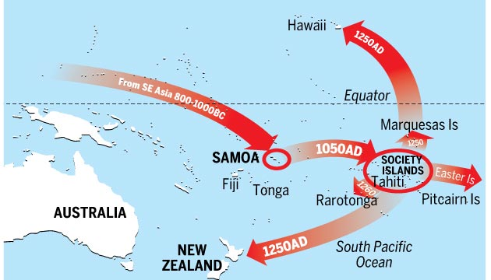
Māori – background and context
Māori today:
Growing population: almost 1M people with Māori ancestry (843 000 in New Zealand, > 100K in Australia)
Cultural renaissance, tribal-based settlements for historical Treaty of Waitangi breaches - $ + assets
Strong Māori presence in primary and health sectors
Contemporary health Status
Generally poorer than mainstream
Heritable conditions:
metabolic conditions (CVD, gout T2D), some Mendelian conditions with Māori/Polynesian
Overrepresented in cancer-related deaths, mental health statistics, oral health and metabolic conditions
Some Mendelian conditions
Many ancestry-specific disease-associated gene variants
First humans to arrive in NZ/Aotearoa ca. 800 years ago
Polynesian language & culture
‘Archaic Eastern Polynesian’ -> ‘Classic Māori’ culture
Treaty of Waitangi 1840 -> British colonisation early 19th Century onwards
Large influx after signing of
established military superiority late 1860s
Systematic loss of lives (diseases and warfare), land, language, knowledge, culture, education systems etc

Slide 11
Outline
1. Indigenous peoples and science
2. Māori concepts of hereditary inheritance used on a daily basis
3. Examples of indigenous led/co-led research
4. Education initiatives

Slide 12
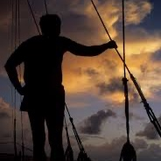
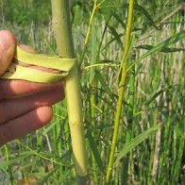
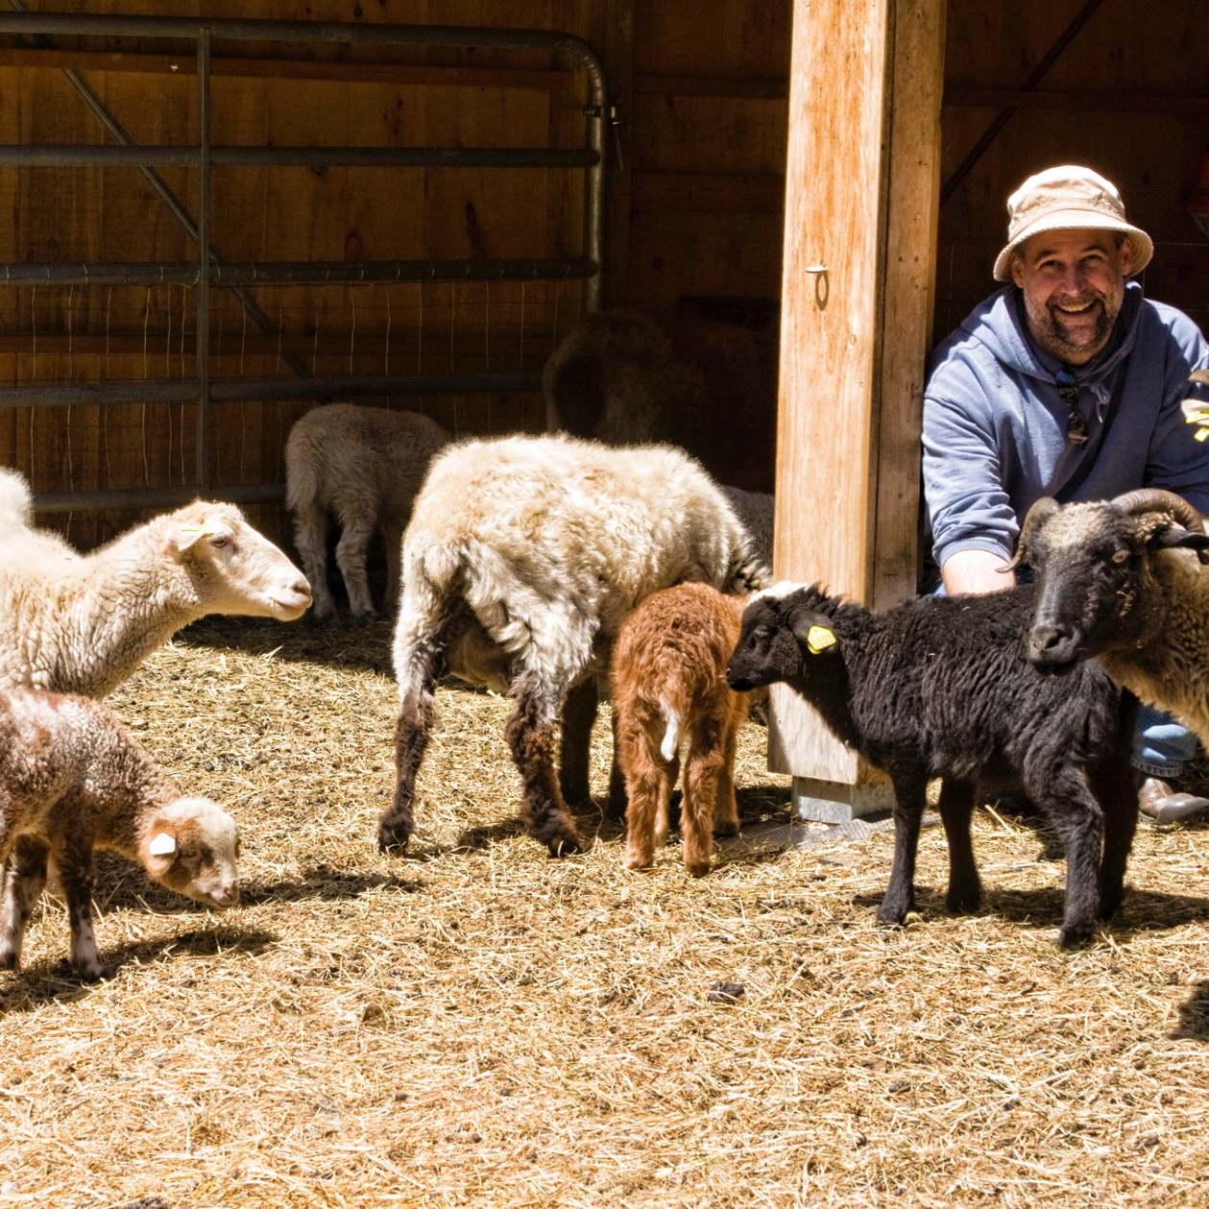
Indigenous People have always been scientists
Polynesian navigation
Plant and medicinal knowledge
Diné understanding of genetics
Indigenous people used traditional knowledge from generations of experiential learning and repeated observations to understand the world around them.
Indigenous scientists exist pre-dating universities.

Slide 13
The Over-Dichotomization of Knowledge Systems is Related to Power Imbalances
SCIENCE
Western Academic “Science”
Indigenous Knowledges (IKs)
Research defined in terms of “discovery”
Used a tool for the colonization of Indigenous peoples and their territories
“problematizing the indigenous”, according to Linda Tuhiwai Smith
Indigenous people have their own ways of knowing for time immemorial
More holistic versus “part of a whole”
Ensures that research on Indigenous issues are more respectful, ethical, sympathetic, useful or beneficial for Indigenous peoples
NOT
VS

Slide 14
Changing the framework… starts with placing modern genetics within Indigenous practices
Indigenous concepts of hereditary inheritance
Indigenous led/co-led research
Culturally informed ethical frameworks
Indigenous data sovereignty
Indigenous focused education in genomics and related areas…

Slide 15
Some Key Māori Concepts of Genetic Inheritance
Many concepts…
Well known and utilised
Examples:
Tribal naming conventions
Constructs such as ‘whakapapa’, ‘pepeha’ and ‘mokopuna’
Selective Breeding…

Slide 16
i. Tribal Naming Conventions…
‘Iwi’ = bones
‘Hapū’ = pregnant
Ngāti or Ngai = ‘people of’
Te Tini = ‘the multitudes of’
Te Aitanga = the descendants of…

Slide 17
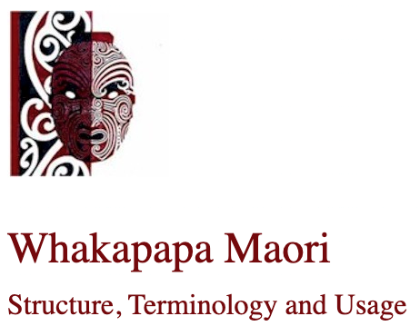
Whakapapa
Key concept in te ao Māori
Both a genetic and social construct
Literally ‘to place in layers…’ (see https://maaori.com/whakapapa/whakpap2.htm)
Whakapapa refers to both genealogies AND spiritual, mythological and human ‘purākau’ – stories/histories = ‘flesh’ to the genealogical ‘bones’
Tātai/Kawai = genealogical component
Whakapapa widely known (80% of Māori know at least some of their whakapapa)
"Before the coming of the Pakeha [European] to New Zealand with his superior technology, all literature in Maori was oral. Its transmission to succeeding generations was also oral and a great body of literature, which includes haka [dance], waiata [song], tauparapara [chant], karanga [chant], poroporoaki [farewell], paki waitara [stories], whakapapa [genealogy], whakatauki [proverbs] and pepeha [tribal sayings], was retained and learnt by each new generation."
- Sir Timoti Karetu, "Language and Protocol of the Marae [meeting place], in Te Ao Hurihuri, ed Michael King, 1975, Longman Paul, Auckland

Slide 18
Two Māori co-led projects – aim to deliver health benefits for Māori from Genomic Data
Aotearoa Variome Project (2018 – current)
Aim to develop a catalogue of genetic variants in contemporary Māori in Aotearoa/NZ
Recruit 1000-1500 participants with minimal close ancestry
Utilize deep Māori knowledge of ‘whakapapa’ (ancestry) to monitor and evaluate diversity
Whole genome sequencing
See https://www.genomics-aotearoa.org.nz/projects/aotearoa-nz-genomic-variome
Rakeiora Project (2019-current)
Aim is to develop data sets combining clinical and genomic data for research and clinical applications
Pilot study using participatory action research to identify paths to scale up combined use of genomic data/health records in a culturally appropriate manner
Two ‘arms’:
‘Primary’ care – EHR + WGS data with Ngāti Porou Hauora, tribal health provider
‘Tertiary’ care (Oncology)
See https://www.genomics-aotearoa.org.nz/projects/rakeiora-pathfinder-genomic-medicine
Notes:
HER = electronic health records

Slide 19
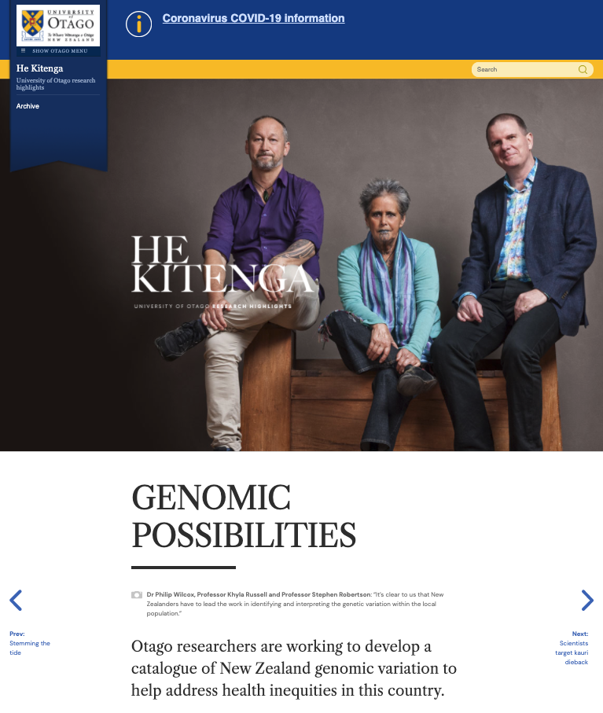
Using Mātauranga Māori in modern genetics research
Aotearoa Variome project – see https://www.genomics-aotearoa.org.nz/projects/aotearoa-nz-genomic-variome
AIM is to create a catalogue of DNA sequence variation within Te Ao Māori for health applications
Whakapapa knowledge (waka/hapu/iwi/whanau) enables recruitment to be efficient
Minimise close relatedness
Target unrepresented whakapapa lineages
WITHIN budget

Slide 20
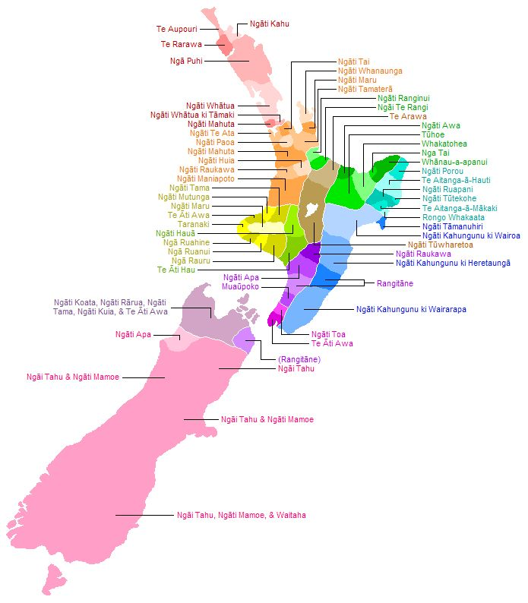
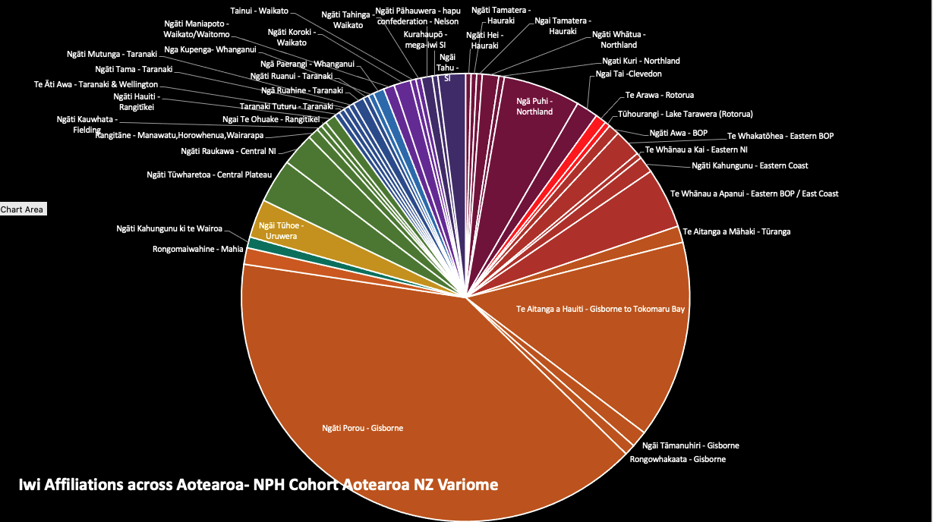
Traditional Ancestral Knowledge of Whakapapa (Genealogy) Enables the Variome Project

Slide 21
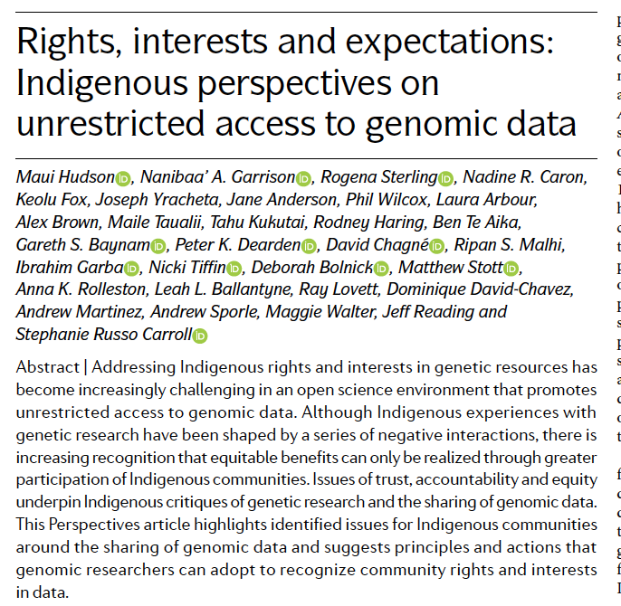
Nature Reviews Genetics 21(6): 377-384.
Notes:
This paper was published earlier this year in Nature Reviews Genetics which outlined three key principles for enhanced responsiveness to Indigenous rights and interests in genomic information (and related data): Building trust, enhancing accountabilities and improved equity and benefits. I’ll cover how these two projects are addressing these principles.

Slide 22
Building Trust… Aotearoa Variome and Rakeiora
Partnering with Māori health providers.. With prior experience in genetic studies -> 3rd party ‘advocacy’
Detailed benefits cases validated by Māori health professionals that responds to stated health needs of community members
Māori-led project governance mechanisms
Key principle: Māori governance over Māori data and genomic resources
Māori co-led in science delivery
Notes:
In both of these projects we have undertaken the following early in the engagement process. We are partnering with Maori Health providers who have prior experience in genetic studies,

Slide 23
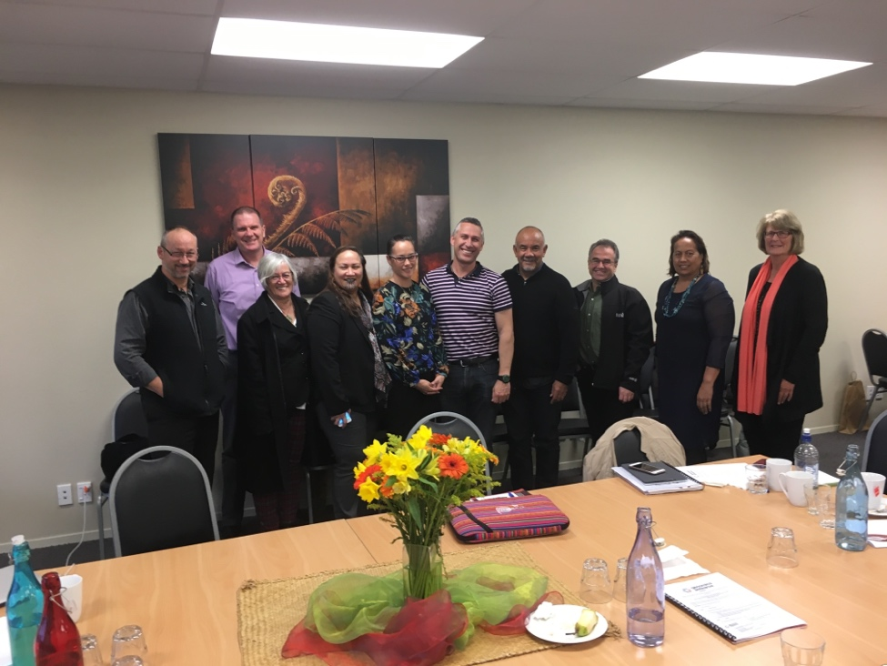
Variome Project Leadership and Governance
‘he taonga he tapu, nā te tapu ka puta mai te tikanga’
Leadership Roopu
Hon. Te Ururoa Flavell (Chair)
Huti Watson (Chair 2020 ->)
Irene Kereama Royal
Dr Helen Wihongi
A/Prof Maui Hudson
Dr Andrew Sporle
Dr Jennie Harre-Hindmarsh
Dr Anna Rolleston
Prof Khyla Russell
Roles
Lead the conversation with communities
Double check for the kaupapa
Benefits case
Advise researchers regarding study design and conduct
Interim governance
Ensure activities are aligned with community priorities
External communication
T
Notes:
Members have health and/or research backgrounds, nationally known in some cases, experience in tribal governance.

Slide 24
Enhancing Accountability
Aotearoa Variome
Formal contracts with Māori partners for recruitment etc
No secondary use within project
Data are owned by participant who can reassign ownership
Variome will be permanently anonymized: an aggregated summary of population-level data
Use of Mātauranga Māori (= traditional knowledge) to improve design and quality of database
Overarching Māori leadership roopu (group)
Tribal approvals-in-principle
Individual consent -> return data
Rakeiora
Dual governance mechanisms:
Primary care: tribal ownership and oversight from Ngāti Porou Hauora (https://www.nph.org.nz/about-us)
Tertiary care: non-tribal governance developing engagement framework
Co-design with participants (primary care)
Mechanisms being developed for
recognizing origin of knowledge
(de)federating-at-will

Slide 25
Improving Equity
Aotearoa Variome
Māori health providers as partners -> training community members
Translation mechanisms:
Immediate clinical utility
Māori health providers use of database
Rakeiora
Clinical application of information
Provision of enabling IT = enhancing capacity
Research database under Māori control
integrated database and analysis platforms for NPH
Train indigenous researchers in data analyses, recruitment, etc
Publications

Slide 26
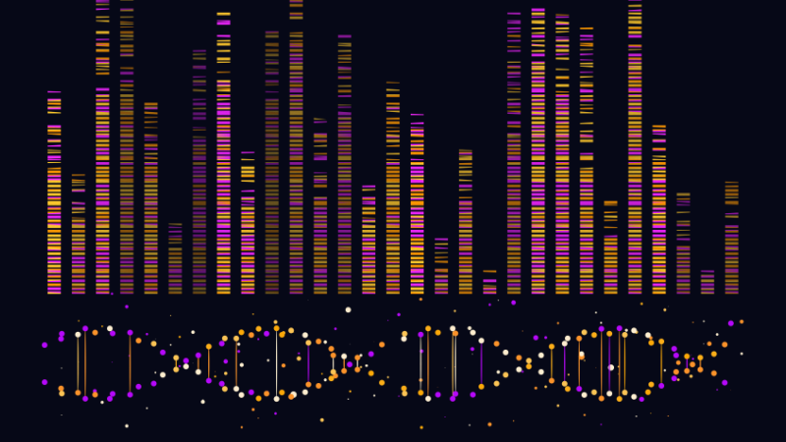
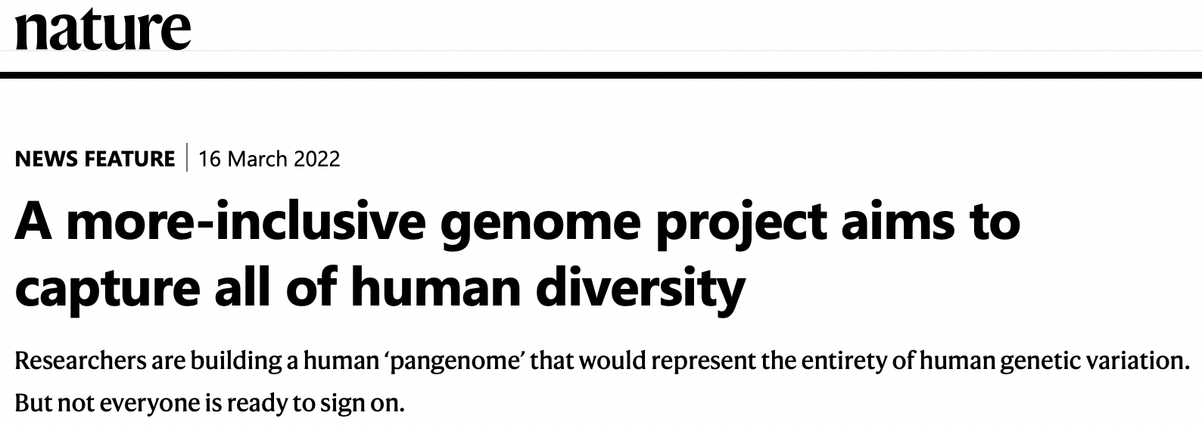

Slide 27
Which Contributes More to Health Inequities? Genomics or Structural Factors?
"In 2018, Indian Health Services spent an average of $3,779 per patient. The national spending per capita that same year was $9,409”
National Indian Health Board
The Cycle of victim-blaming and coercion that Indigenous Peoples experience in research

Slide 28
The right of Indigenous nations and people to exercise autonomy to protect their interests related to genomic data
This right is intrinsically-defined by the community, not defined colonially.
Indigenous
genomic data
sovereignty

Slide 29
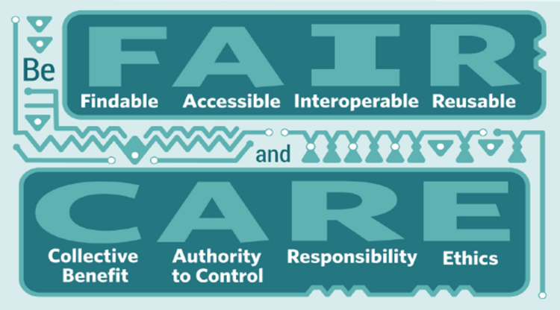
Guiding Principles
for Data Governance and Stewardship
Wilkinson et al. Scientific Data 2016. The FAIR Guiding Principles for scientific data management and stewardship
Carroll et al. The Global Indigenous Data Alliance. 2019. CARE Principles for Indigenous Data Governance

Slide 30
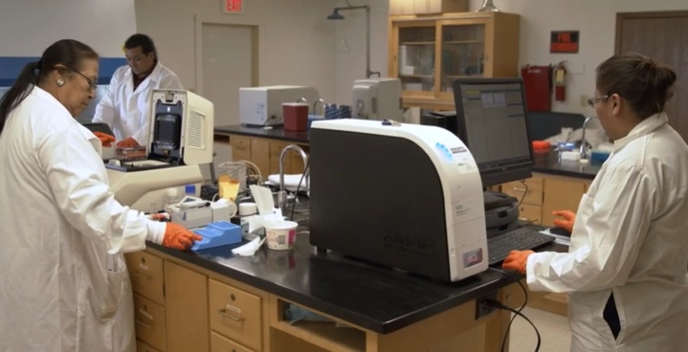
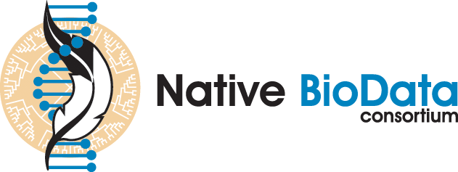

Slide 31
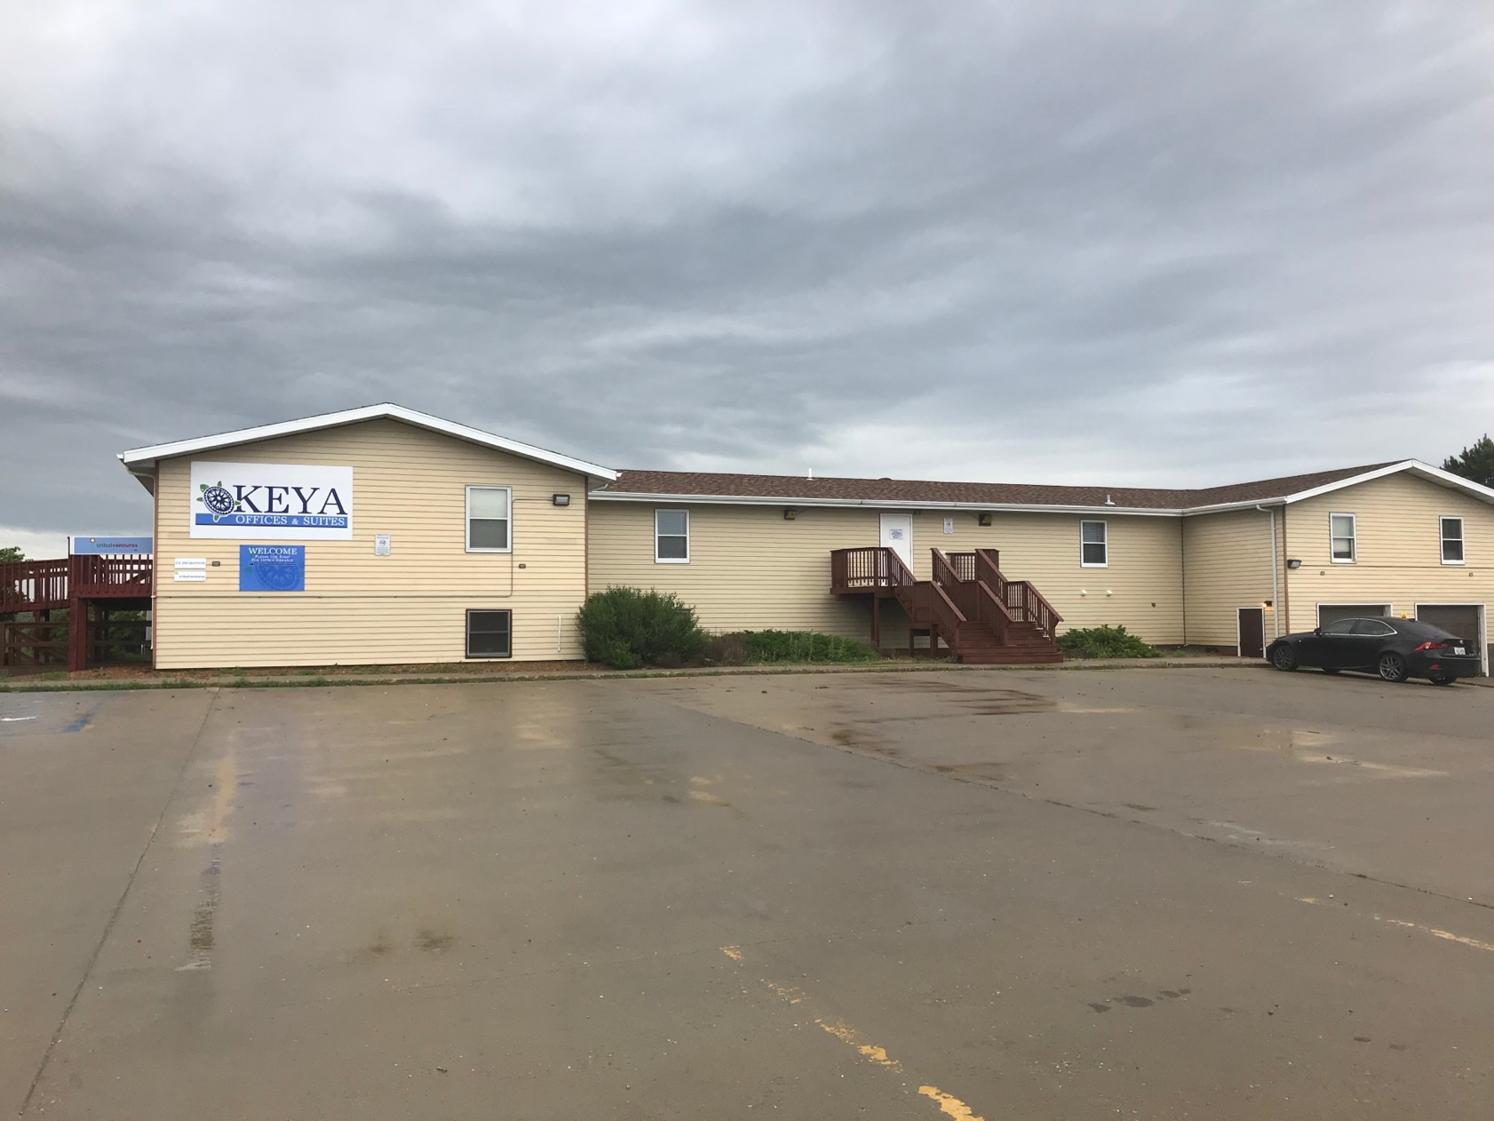
Native BioData Consortium (NBDC)
Many US tribes do not participate in Federally-funded research because dbGAP
But, if tribes could deposit their DNA and data in a tribally-managed biorepository, the story could be different
House samples and data on tribal lands
Look into the research questions that Tribal members are interested in, not reliant on outsider-researchers to investigate for us
@NativeBio

Slide 32
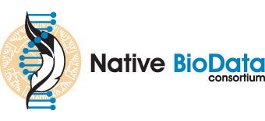
Traditional Knowledge (TK) Labels. Digital markers that define attribution, access, and use rights for Indigenous cultural heritage
Biocultural (BC) Labels. Digital markers for provenance, transparency and integrity in research engagements related to community expectations and consent for use of collections and data.
Dynamic Consent Portal. In Indigenous-led data repository to house Tribally-consented genomic sequence data and manage access and attribution.
Blockchain. A distributed ledger system that tracks sharing via transactions, can fine-tune user access, attribute provenance, and facilitate data governance.
Federated learning. To facilitate secure and community-consented data sharing.
DIGITAL TOOLS TO PROTECT INDIGENOUS GENOMIC DATA SOVEREIGNTY

Slide 34
Benefits of Dynamic Consent Web Portal
places participants as key decision-makers
a personalized, digital interface to connect researchers-participants
adaptive to participant decisions
still responsive to tribal community-level research regulation
improves transparency and promotes public trust
reduces burden of participant recruitment and recontact

Slide 35
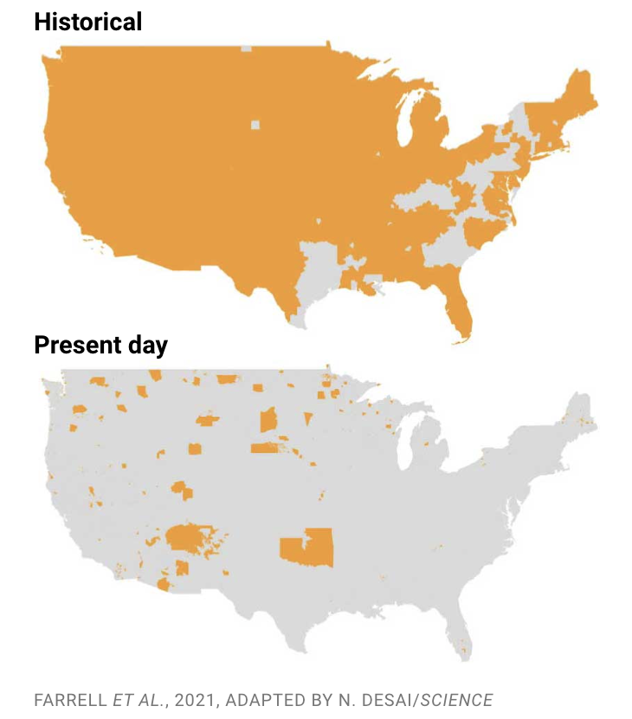
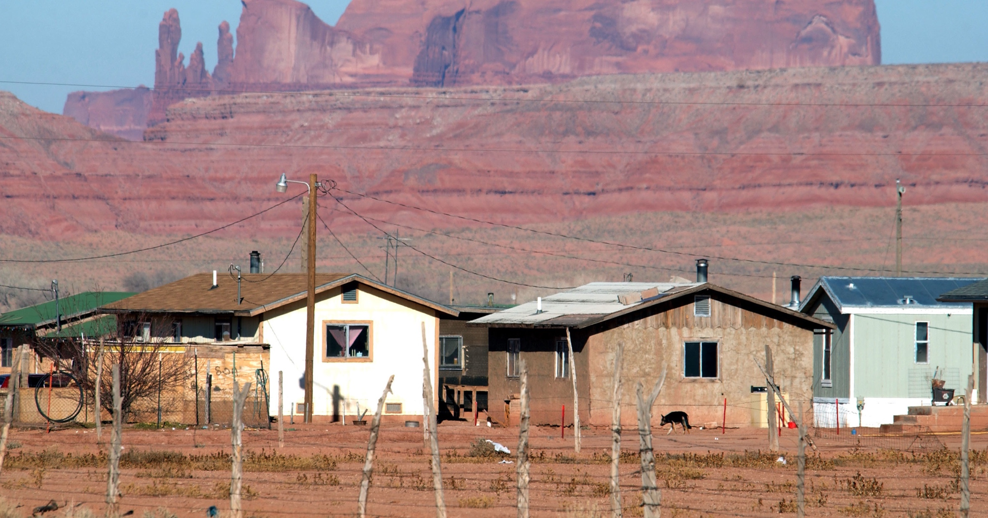
Build local data economies
“Indigenous people across the contiguous United States have lost 98.9% of their historical lands”
Science Oct 2021
“just 67% of tribal lands in the continental U.S. have access to broadband internet”
American Indian Policy Institute

Slide 36
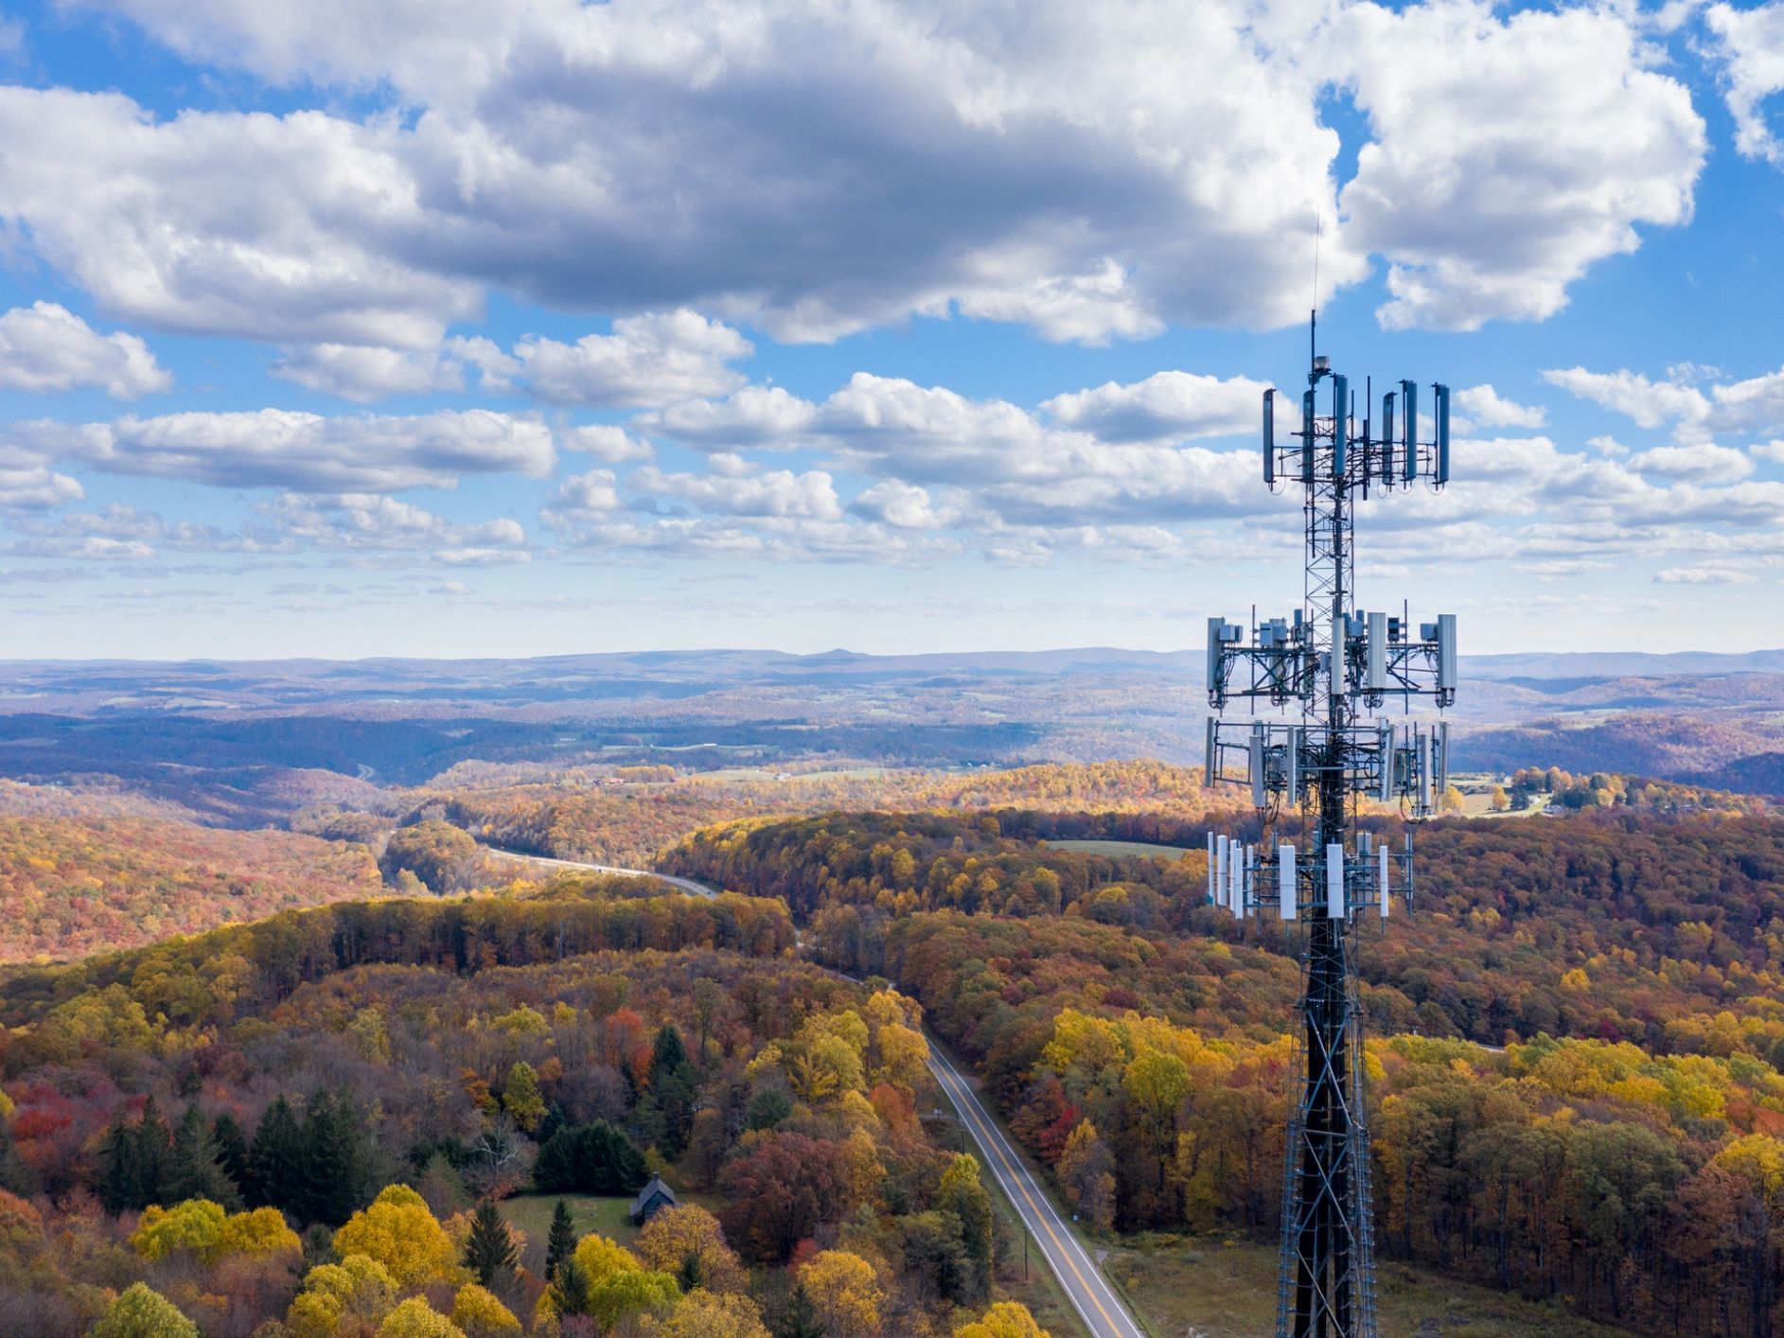
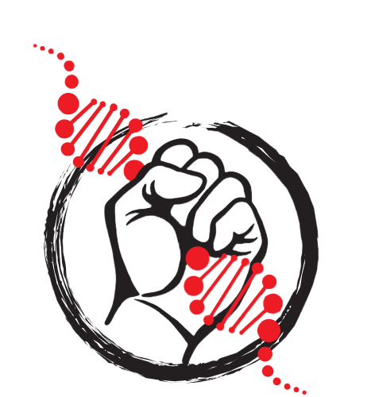
Indigenous Data Revolution:
Indigenous Data Sovereignty through Tribal Law
Indigenous Data Repositories
Digital Data Tools
Expanding Tribal-Based Broadband and Data Capacity
Indigenous Cloud Solutions?

Slide 37
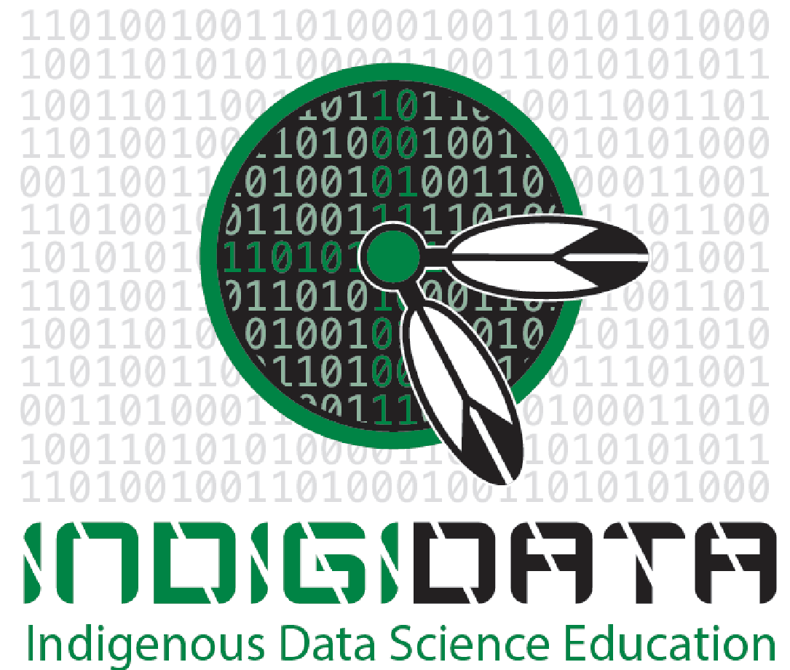
Trainings Within an Indigenous Context
Summer internship for INdigenous people in Genomics (SING)
Initiated in 2011
Trained ~120 participants from ~60 Tribal Nations/communities
Expanded globally
Produced high impact guidelines
Formed a trainee and investigator support system in genetics
IndigiData: Indigenous Data Science
Initiated in 2021
Focus on informatics of biological systems
Performed on site at NBDC
Includes Alaska Natives and First Nations communities

Slide 38
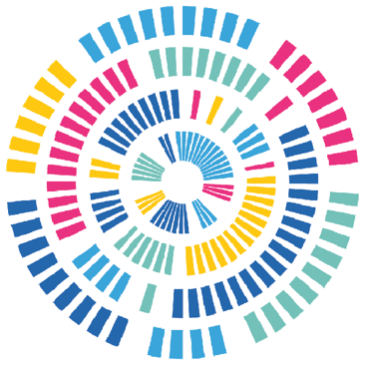
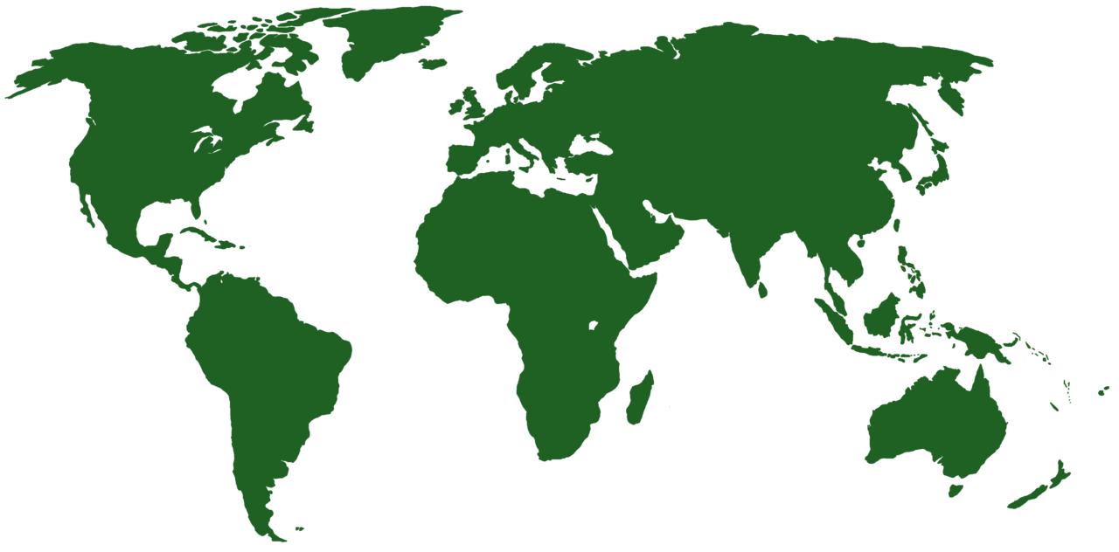
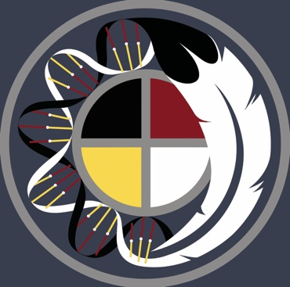
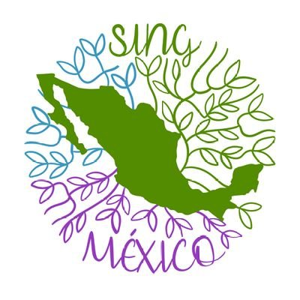
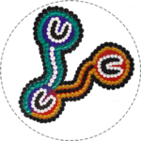
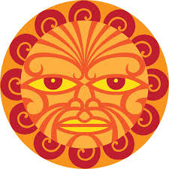
SING Greenland
?
SING Canada
2018
SING USA
2011
SING Mexico
2023
SING Australia
2019
SING Chile
?
SING Aotearoa
2016

Slide 39
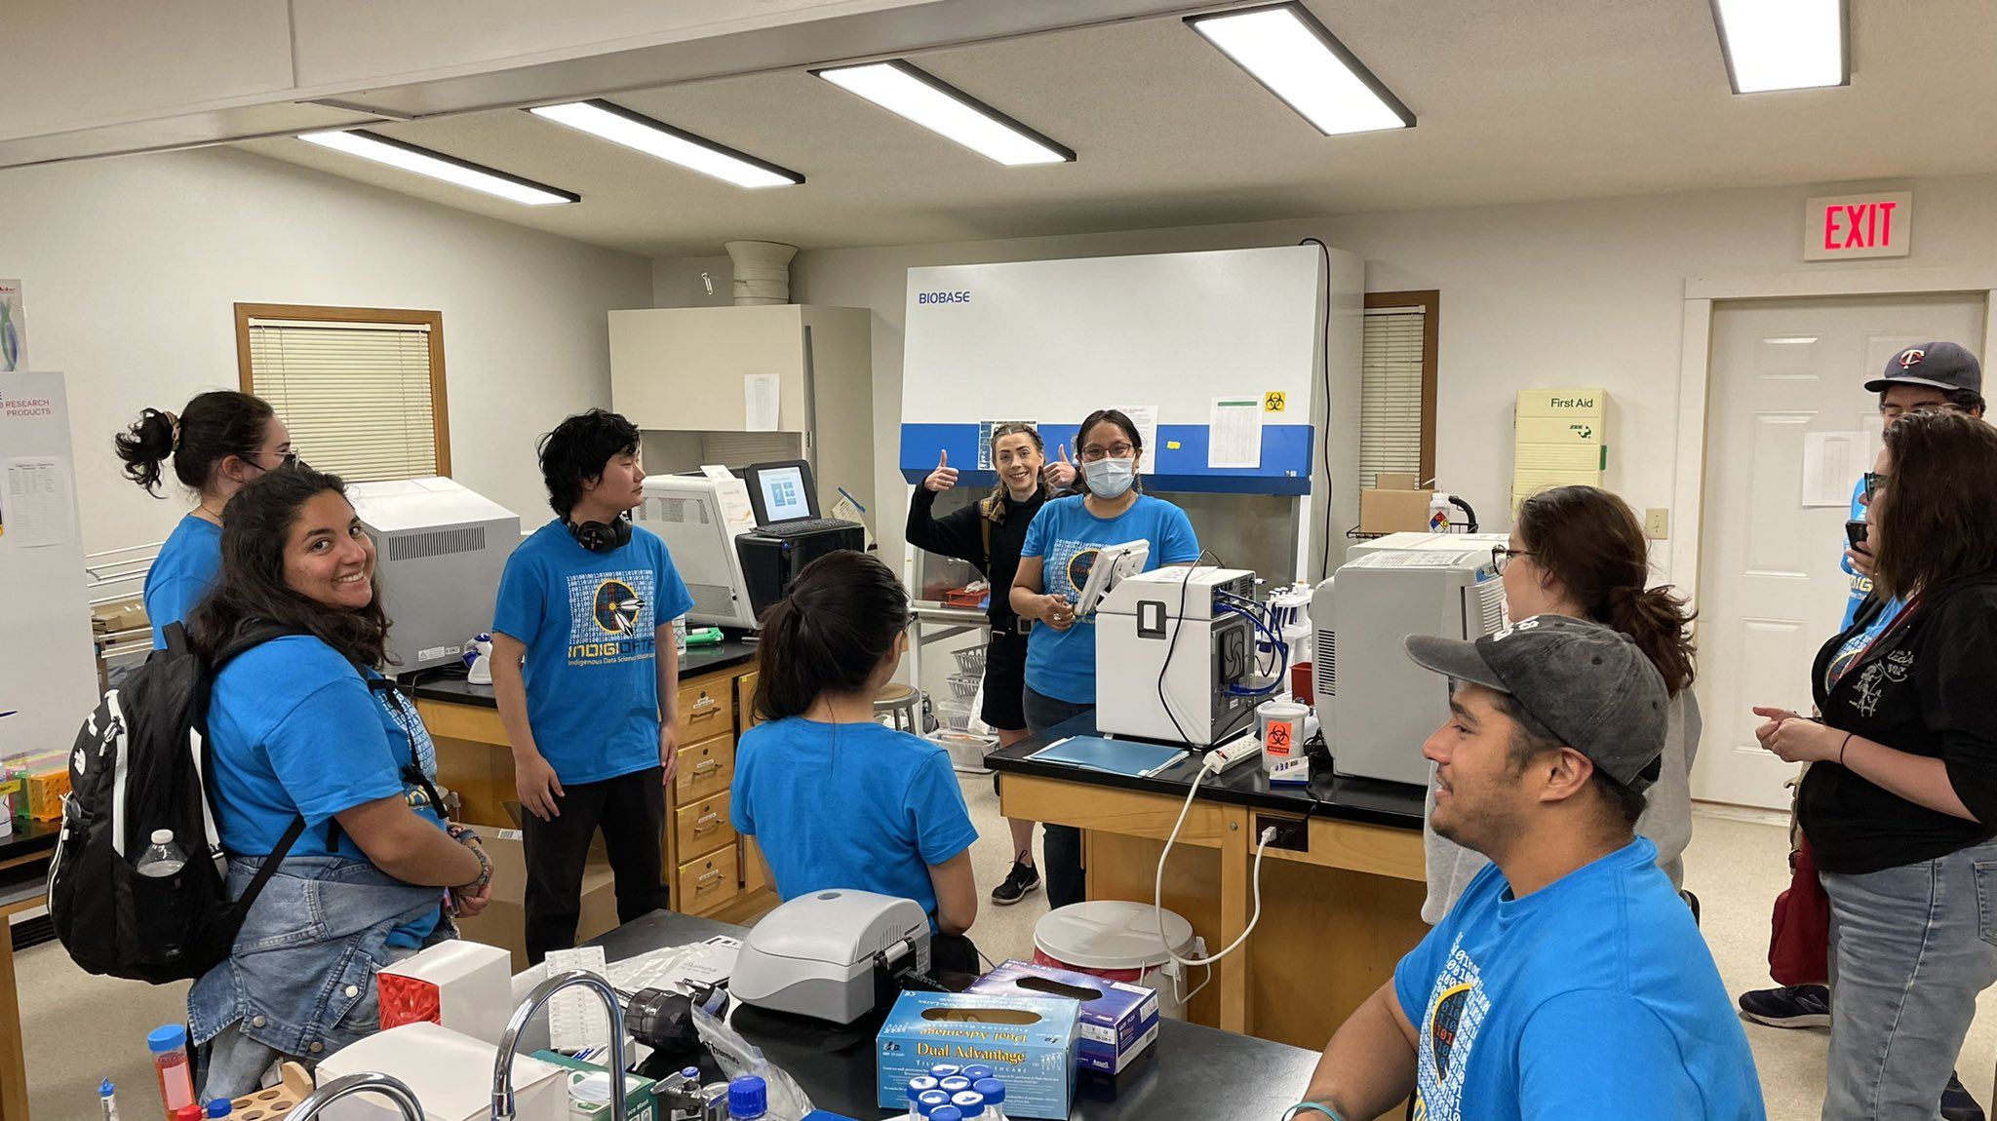
IndigiData.org
Empowering the Next Generation of Indigenous Data Scientists

Slide 40
