Slide 1
CERA Traineehub: Finding and Making Sense of NIH Funding Opportunities
Tuesday October 3, 2023
Dave Kaufman, Marsha Michie & Maya Sabatello

Slide 2
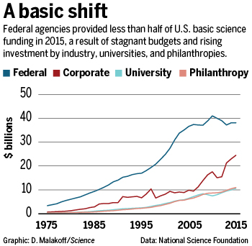
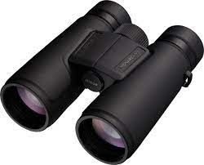
There are different funding agencies and opportunities
NIH Grants
National Science Foundation
University
Philanthropy

Slide 3
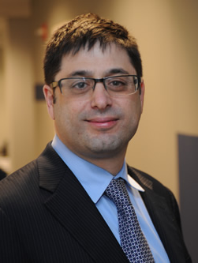
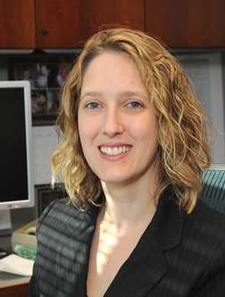
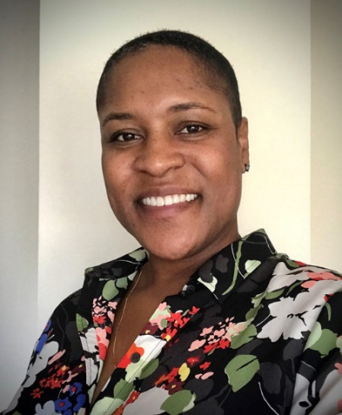
ELSI Research Program Staff
Larry Brody
Director, Division of Genomics & Society
Dave Kaufman
Program Officer
Nicole Lockhart
Program Officer
Rene Sterling
Program Officer
Sarah Anstice, Scientific Program Analyst
Zo Bly, Scientific Program Analyst

Slide 4
Wait! What is a program officer?
The program officers (POs) are NIH staff who:
Put the ‘fun’* in funding opportunities
Discuss whether an idea is a good fit
Provide feedback on specific aims
Discuss summary statement after review
Jargon alert: Program officers are listed as “Scientific/Research Contacts” at the end of Funding Opportunities

Slide 5
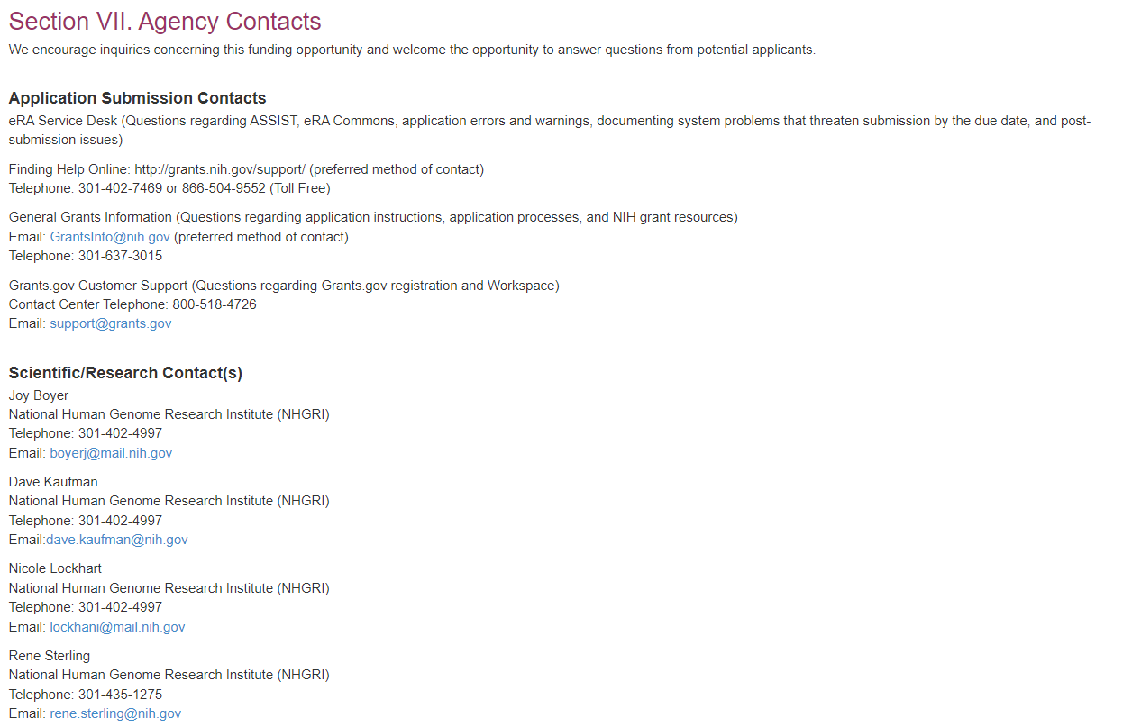
To find us, skip to the end (of NOFOs)

Slide 6
And…a NOFO?
NIH advertises grant support through Notices of Funding Opportunity
Each NOFO includes all information and requirements to assess your eligibility and interest
Organization and much content of a NOFO is defined by the Office of Management and Budget (OMB)
Recommended for insomnia

Slide 7
Where do I find ‘Funding Opportunities’?
NIH Guide: https://grants.nih.gov/funding/searchguide/index.html#/
NIH Reporter & Matchmaker >> reverse engineering
https://reporter.nih.gov/matchmaker
Notes:
NIH Guide is updated daily , where all announcements are officially published….complete, filterable searchable, imperfect,
Weekly NIH Guide Subscription https://list.nih.gov/cgi-bin/wa.exe?SUBED1=NIHTOC-L&A=1
NIH Guide: https://grants.nih.gov/funding/searchguide/index.html#/
NIH Reporter & Matchmaker:
https://reporter.nih.gov/matchmaker
Reporter & Matchmaker Tutorial Video https://www.youtube.com/watch?v=azTrSIrEYUM Using RePORT to Understand Who and What NIH Funds

Slide 8
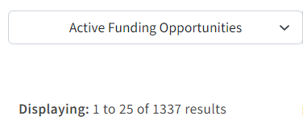

Slide 11
Where do I find ELSI Funding Opportunities?
NHGRI ELSI webpage: https://genome.gov/elsi
Join the ELSI listserv (email: ELSI@nhgri.nih.gov)
NHGRI Funding for Research Training webpage
Notes:
Start with the easy answers that have been curated for ELSI investigators, Particularly
ELSI Hub https://elsihub.org/funding
ELSI webpage: https://genome.gov/elsi
ELSI listserv (email: ELSI@nhgri.nih.gov)
NHGRI Funding for Research Training webpage https://www.genome.gov/careers-training/NHGRI-Funding-Opportunities-Training-Career-Development

Slide 12
What am I looking for?

Slide 13
Fit Responsiveness and Review Criteria Application Instructions

Slide 14
Fit, at a high level
Reflects your
scientific goals,
interests*
Funding
Opportunity
Timing
Eligibility
Length, Cost,
Complexity

Slide 15
Notes:
For some reason located between Part 1 and Part 2
Hyperlinked to sections
Part 1
Part 2

Slide 16
Fit: Eligibility – don’t assume either way Career Development, Fellowships
Eligibility of your Institution
People at foreign institutions, as lead or component
Eligibility of you, other PIs
Training and/or career stage
New or early investigator
Underrepresetned groups in science
Profession

Slide 18
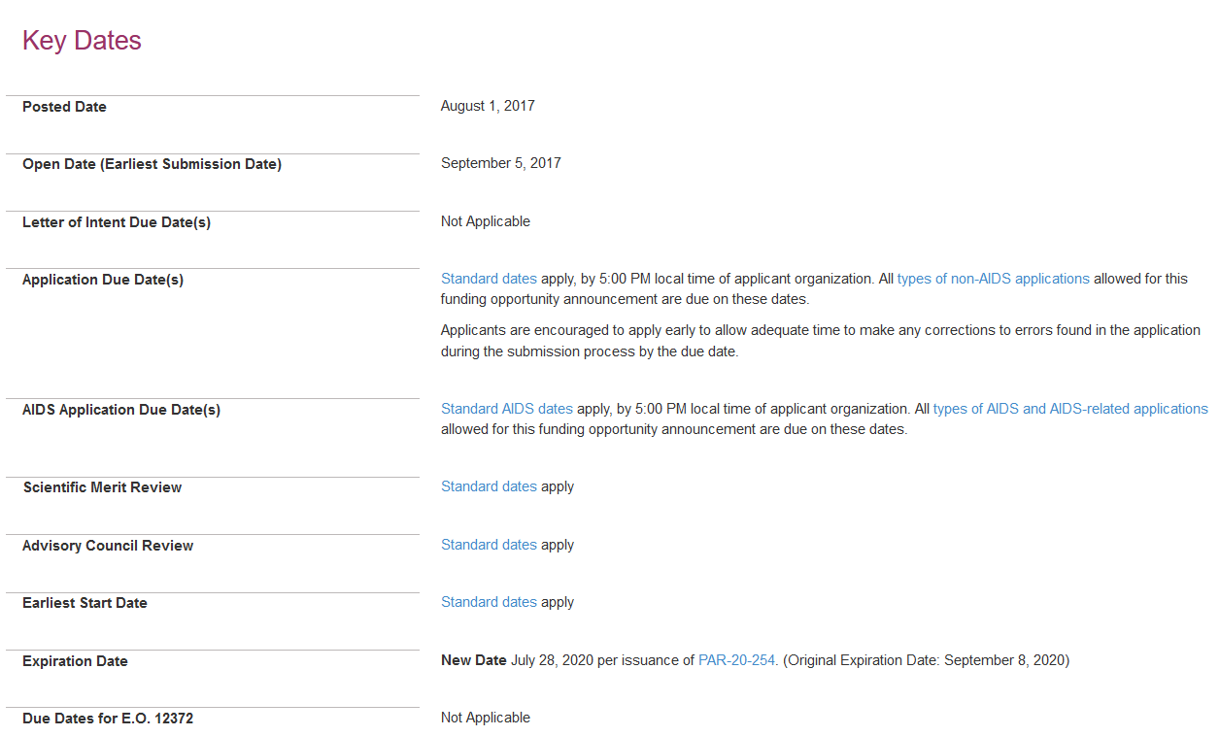
Fit: Timing - Is the Notice still Active, or Expired?
https://grants.nih.gov/grants/guide/pa-files/pa-17-444.html
Notes:
Its easy to wind up looking at a Funding Opportunity that is no longer active
To check scroll down to Key Dates and look for the Expiration Date - this old ELSI opportunity is expired.
https://grants.nih.gov/grants/guide/pa-files/pa-17-444.html

Slide 19
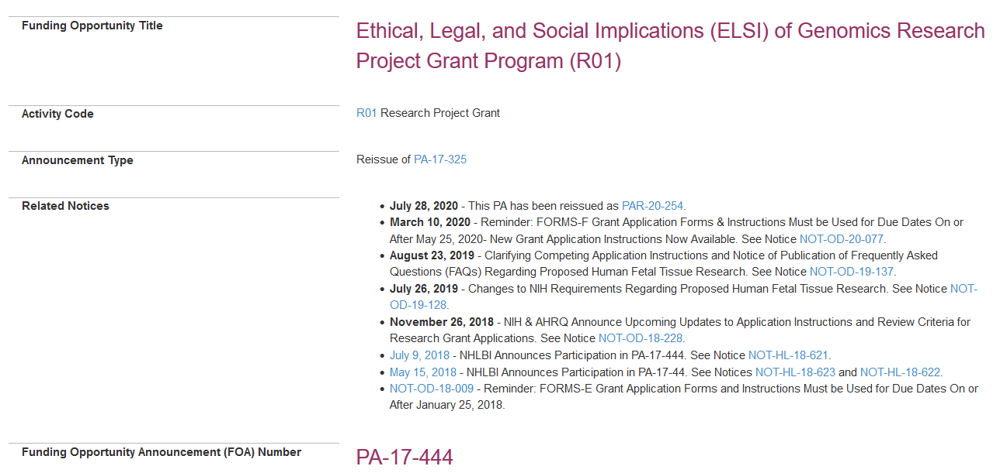
Was it reissued?
https://grants.nih.gov/grants/guide/pa-files/pa-17-444.html

Slide 20
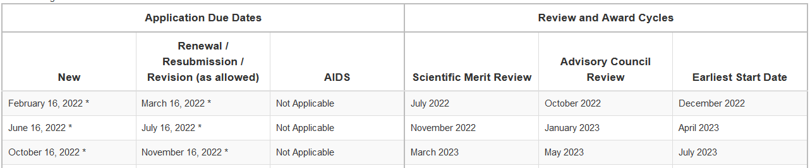
Application --- Funding timeline
Example from a NOFO
Also common: NIH standard due dates
Notes:
Many announcements are now showing dates as a table – each line is a “cycle of grant submission, review and earliest funding date for that cycle about 10 months minimum
The first column shows the due dates for submission of NEW grant ideas
The second column shows a different set of due dates for Resubmission your second go-round, responding to comments from your first review if it didn’t go perfectly. [Some don’t allow for any/all of these types, goods to check.]
https://grants.nih.gov/grants/how-to-apply-application-guide/due-dates-and-submission-policies/due-dates.htm

Slide 21
Apply early…
Before the due date to ensure you have time to make any application corrections that might be necessary for successful submission.
Your Institution will also usually require things be sent to them to submit early
When a submission date falls on a weekend or Federal holiday, the application deadline is automatically extended to the next business day.

Slide 22
Fit: Project Length, Cost and Complexity
Lots of factors! Consider:
Do you have preliminary data already?
How much time will you need to complete the project?
How big is your likely budget?
How much experience do you have leading projects/grants?
Also: CTRL-F search $, year
Notes:
A lot of factors! Consider:
How much time will you need to complete the project?
How big is your likely budget?
What’s your starting point - do you need preliminary data?
How much experience do you have in leading projects/grants?
Check Part 2 Section 2, Award Information
And always CTRL-F search for “$” ; “years” don’t assume cost and time limits are always the same

Slide 23
Range of Funding Opportunities (Research Grants)
Activity
R03
R21
R01
Cooperative Agreements (U)
Center Grants, Consortia
Budget
Project length
Complexity
$$
2 years
No prelim data
$$$
3 – 5 years
Prelim data required
$$$$
4 – 5 years
Complex project
$
1 – 2 years
No prelim data
Undergrad
Grad Student
Post-doc
Early Faculty
Notes:
Most early researchers are
Check Part 2 Section 2, Award Information
And always CTRL-F search for “$” ; “years” don’t assume cost and time limits are always the same
ASK

Slide 24
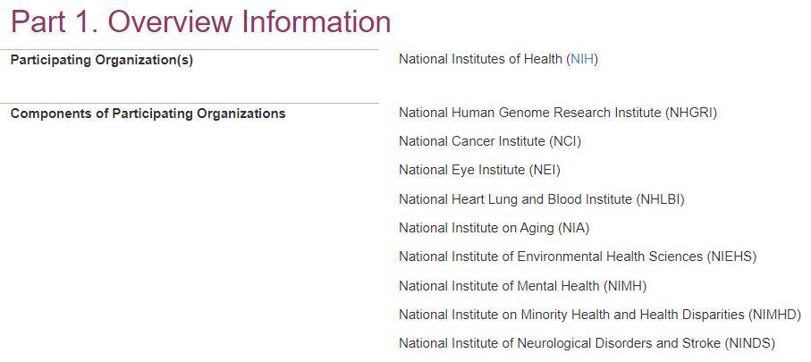
Does the Notice of Funding Opportunity (NOFO) ‘Fit’ Your Scientific Goals?
A. Which Institutes are participating?
Notes:
At this point if the shoe fits on timing, budget and scope, but you aren’t sure about scientific fit that you might reach out to a program officer to see if a topic you have in mind is “In Scope”
Which Institutes are participating?
Especially important to check on if you are focused on a disease/phenotype

Slide 25
Scientific fit
B. What are their interests? Check:
Funding Opportunity Purpose
Part 2. Section I
Key Objectives, Themes
Research Interests by Institute
Examples of Questions or Outcomes
Responsiveness, Non-responsiveness
Part 2. Section V
Review criteria specific to the NOFO
Reiterating key parts of Section 1
Notes:
Then you want to carefully read what we’ve written about our interests.
3 main places to check - just showing the Table of Contents
The Funding Opportunity Purpose up top is a short focused blurb
Most of the information is in Section 1 or Part 2, the NOFO Description; read this carefully more than one. Different sections, not everyone uses all of them, but look for Background, Objectives, themes, The research interests section where each Institute can get specific, any example of Questions or Outcomes
And What will make the grant Responsive or not

Slide 26
Notes:
https://grants.nih.gov/grants/guide/parent_announcements.htm

Slide 27
NIH Parent Announcements
+ When you don’t see your idea in an RFA,PAR, or NOSI
+ Many activity codes have parents
Research R01, R21, R03
Training (K’s) and Fellowships (F’s)
+ Many (not all) Institutes sign on
+ Basic NOFO for that activity code
Legwork
Before applying, ideally you want to find a potential home, shepherd
Institute, Program Officer (reach out)
Are my Aims a fit?
Review panels?
“The proposed project must be related to the programmatic interests of one or more of the
participating NIH Institutes and Centers (ICs) based on their scientific missions.”
https://grants.nih.gov/grants/guide/parent_announcements.htm
Notes:
https://grants.nih.gov/grants/guide/parent_announcements.htm
NIH Reporter, Matchmaker
NIH Reporter and Matchmaker Video https://www.youtube.com/watch?v=azTrSIrEYUM

Slide 28
Responsiveness Non-Responsiveness* NIH Priorities Application materials Application requirements NOFO Specific Data sharing plan Other attachments Appendix Review Criteria [NOFO-Specific] Where to get help
Grantspersonship

Slide 29
Examples of specific research areas of interest include, but are not limited to
The purpose of this NOFO is to….
Relevant issues include
Applicants should use/utilize/ focus on/
Applicants should consider
Proposed methods may include
Applicants are strongly encouraged to contact NIH scientific program officers
Applications may propose
It is expected that….
Research Topics of Low Priority
Successful applications will
Non-Responsiveness Criteria

Slide 31
Gather and meet with your team early on
advisors &
co-investigators
NIH scientific contacts
scientific fit
size and scope
eligibility
eRA Commons Help Desk
Grants Management contact
your institution’s
grant management
team
grant forms
registration
submission
policy and budget
If you wait they may not have time to help!
Notes:
https://www.era.nih.gov/need-help eRA Commons
Toll-free: 1-866-504-9552 (Press 1 for eRA Commons or ASSIST)

Slide 32
Thanks!
Marsha Michie
Maya Sabatello
Nicole Lockhart
Rene Sterling
Tiana Sepahpour
Mildred Cho

Slide 33
Questions & Discussion

Slide 34
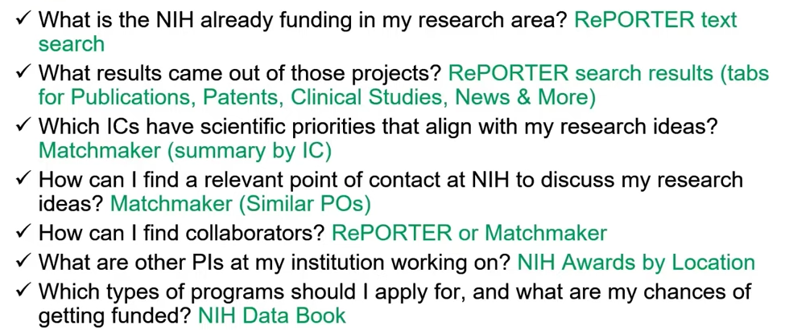
NIH Reporter and Matchmaker Functions

Slide 35
Fit: NIH’s broad or narrow interests? Check NOFO type
 | NOFO Type
 | RFA Request for Applications | NOSI Notice of Specific Interest | PA/PAR Program Announcement | Parent Announcement
Research Area | Specific. | Signals particular interests; adds them to existing NOFOs | General, usually has broader goals and areas specified. | Very general to none. Some Institutes may have areas of interest listed
Example | Responsibly Reporting Back Environmental Health and Non-Genomic Research Results R01 | NOSI: Administrative Supplement for Research and Capacity Building Efforts Related to Bioethical Issues | Ethical, Legal and Social Implications (ELSI) Research R01 | NIH Exploratory/ Developmental Research Grant Program R21
Notes:
RFA https://grants.nih.gov/grants/guide/rfa-files/RFA-ES-23-006.html
PA/PAR https://grants.nih.gov/grants/guide/pa-files/par-20-254.html
Parent https://grants.nih.gov/grants/guide/pa-files/PA-20-195.html
NOSI https://grants.nih.gov/grants/guide/notice-files/NOT-OD-22-026.html

